Slide 1

Attention Is All You Need
The Task for Machine Translation
NIPS 2017
Student: 尹心忠 V1B1
胡滋紜 V2B4
Advisor: 連震杰 教授
Robotics Lab, CSIE NCKU
Edited date: 2024/04/01

Slide 2
Outline
1. Introduction
1.1 Motivation and Objective
1.2 Global Framework
1.3 Contribution
2. The architecture of Transformer
2.1 Attention mechanism: Single Attention.
2.2 Attention mechanism: Multi-Head Attention
2.3 Position-wise Feed-Forward Networks & Embeddings and Softmax
2.4 Positional Encoding [9]
3. Experimental Results
3.1 Data Collection
3.2 Experimental Results
4. Conclusion
5. References

Slide 3
1.1 Introduction: Motivation and Objective (1/3)
胡
1. Motivation:
1) The fundamental constraint of sequential computation:
- Recurrent models typically factor computation along the symbol positions of the input and output sequences.
Aligning the positions to steps in computation time, they generate a sequence of hidden states h_{t}, as a function of the previous hidden state h_{t−1} and the input for position t.
This inherently sequential nature precludes parallelization within training examples, which becomes critical at longer sequence lengths, as memory constraints limit batching across examples.
2) Attention mechanisms are used in conjunction with a recurrent network:
- Attention mechanisms have become an integral part of compelling sequence modeling and transduction models in various tasks, allowing modeling of dependencies without regard to their distance in the input or output sequences [2, 16].

Slide 4
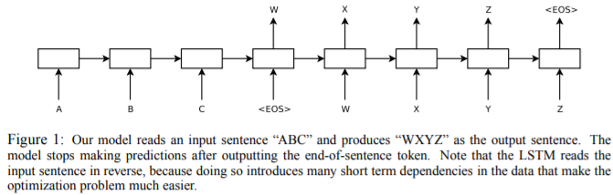
1.1 Introduction: Motivation, Objective and Global Framework ??
1. Motivation: Reducing sequential computation.
Applied to translation tasks: Input sequence/ Output same size sequence.
On WMT 2014 English-to-German translation task: Achieves 28.4 BLEU
improving over the existing best results, including ensembles, by over 2 BLEU.
On WMT 2014 English-to-French translation task: Achieves BLEU score of 41.8
training for 3.5 days on 8 GPUs.
The dominant sequence transduction models:
Based on complex recurrent (RNN): Use one-way RNN or two-way RNN.
The problem of RNN: difficult to process in parallel => propose to replace RNN with CNN.
* Seq2seq (Sequence to Sequence) [35] model: composed of two RNN, Encoder and Decoder respectively. applied to machine translation.
2) Convolutional neural networks (CNN): Each triangle ?? (3 or 5) represents a filter input as a small segment of the sequence.
Reducing sequential computation also forms the foundation of the Extended Neural GPU [16], ByteNet [18] and ConvS2S [9]: Parallel for all input and output positions.
The problem of CNN: only considers limited content, while RNN can consider a whole sentence.
To consider long sentences: stack many layers of CNN.
Attention mechanisms: an integral part of compelling sequence modeling and transduction models in various tasks.
- allowing modeling of dependencies without regard to their distance in the input or output sequences [2, 19].
Machine translation model: Seq. transduction
1 token
1 token

Slide 5
1.1 Introduction: Motivation and Objective (2/3)
胡
Objective:
Propose the Transformer, a model architecture eschewing recurrence and instead relying entirely on an attention mechanism to draw global dependencies between input and output.
The Transformer allows for significantly more parallelization and can reach a new state-of-the-art translation quality after being trained for as little as twelve hours on eight P100 GPUs.

Slide 6
1.1 Introduction: Motivation ,Objective and Global Framework
2. Objective: propose new simple network architecture Transformer.
The first transduction model relying entirely on self-attention to compute representations of its input and output without using sequence aligned RNNs or convolution.
Self-attention (intra-attention): an attention mechanism relating different positions of a single sequence in order to compute a representation of the sequence.
Successfully in a variety of tasks: reading comprehension, abstractive summarization, textual entailment and learning task-independent sentence representations [4, 27, 28, 22].
End-to-end memory networks: based on a recurrent attention mechanism instead of sequence aligned recurrence and have been shown to perform well on simple-language question answering and language modeling tasks [34].
Based solely on attention mechanisms.
Dispensing with recurrence and convolutions entirely.
Experiments on two machine translation tasks show these models to be superior in quality.
More parallelizable.
Requiring significantly less time to train. (8 NVIDIA P100 GPUs/ 3.5 days)

Slide 7
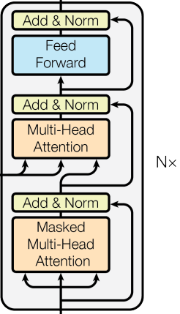
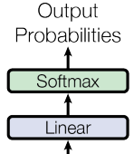
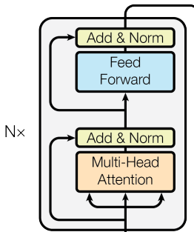

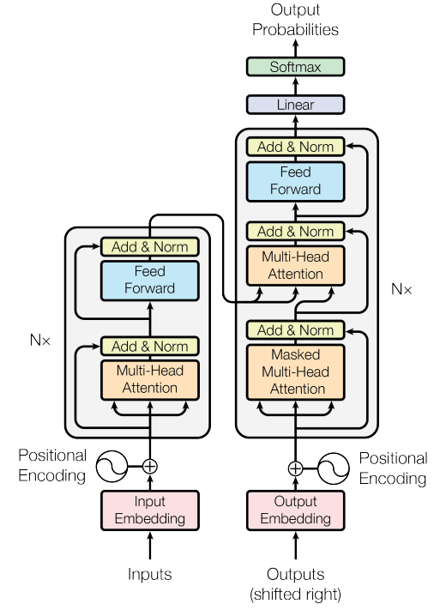
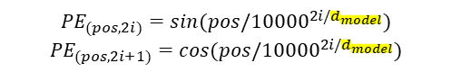
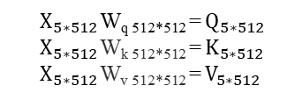
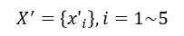
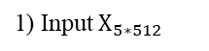
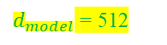
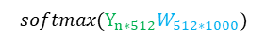
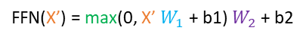
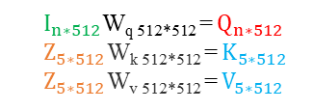
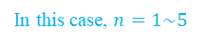
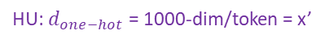
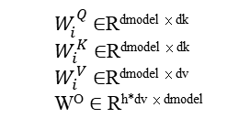
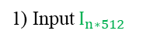
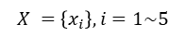
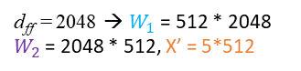
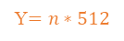
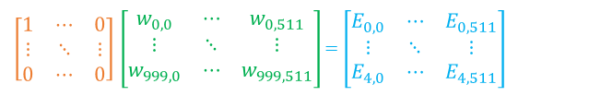
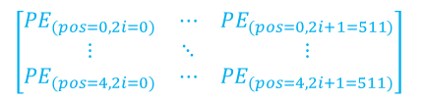

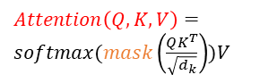
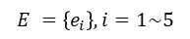

1.1 Introduction: Global Framework - Transformer (3/3-1/2)
以英翻中為例
胡
1.2.1 Related Works: Transformer (1/4-1/2)
2. QKV Encoder - Generate Key K and Value V Using TLM Encoder Stacks
3. QKV Decoder - Generate Output Probabilities Using Decoder Stacks
Transformer Layer Module (TLM)
Y$=n∗512$
FFN(X’) = max(0, X’ $W_{1}$ + b1) $W_{2}$ + b2
5) Feed Forward:
6) Linear Transformation and Softmax
7)
ReLU
d_{ff} = 2048 → $W_{1}$ = 512 * 2048
$W_{2}$ = 2048 * 512, X’ = 5*512
4)Add & Norm:
X’=LayerNorm(X + Sublayer(X))
Z =5*512
$$softmax(Y_{n∗512}W_{512∗1000})$$
Linear transformation
6)
3) Calculate Multi-Head Self-Attention
4)
n*512
H =
(5*64) for each head
5) Multi-Head Cross Attention
$$i=1 \sim h(=8)$$
5)
$I_{n∗512}$W_{q 512*512} = $Q_{n∗512}$
$Z_{5∗512}$W_{k 512*512} = $K_{5∗512}$
$Z_{5∗512}$W_{v 512*512} = $V_{5∗512}$
5)
Q
5x512
K
$Attention\left(Q,K,V\right)=softmax\left(\frac{QK^{T}}{\sqrt{d_{k}}}\right)V$
V
= 6
$QK^{T}$= 5*5 (Self-Attention = Pixel-wise (token-wise) Correlation Matrix)
= 6
4)
X’=5*512
4)
7) Output: Next Token Probabilities (1*1000) 輸出token “很” of 1000 tokens 的機率是最大的，當作下一個輸入字串尾
2) Generate Q, K, V
$W_{i}^{Q}$ ∈R^{dmodel × dk}
$W_{i}^{K}$ ∈R^{dmodel × dk}
$W_{i}^{V}$ ∈R^{dmodel × dv}
W^{O} ∈ R^{h*dv × dmodel}
3) Calculate Masked Multi-Head Attention
$X_{5∗512}$W_{q 512*512} = $Q_{5∗512}$
$X_{5∗512}$W_{k 512*512} = $K_{5∗512}$
$X_{5∗512}$W_{v 512*512} = $V_{5∗512}$
3)
3)
$Attention\left(Q,K,V\right)=softmax(mask\left(\frac{QK^{T}}{\sqrt{d_{k}}}\right))V$
2)
Q
K
V
Q
K
V
2) Generate Q, K, V
1) Input $X_{5∗512}$
d_{k} = d_{v} = d_{model}/h
= 512/8 = 64
2)
1) Input $I_{n∗512}$
1.2 Position Embedding - Inject Token Position Information Using Positional Encoding
$\left[\begin{matrix}{PE}_{(pos=0,2i=0)} & ⋯ & PE_{(pos=0,2i+1=511)} \\ ⋮ & ⋱ & ⋮ \\ {PE}_{(pos=4,2i=0)} & ⋯ & {PE}_{(pos=4,2i+1=511)}\end{matrix}\right]$
$${PE}_{(pos,2i)}=sin(pos/{10000}^{2i/d_{model}})$$
$${PE}_{(pos,2i+1)}=cos(pos/{10000}^{2i/d_{model}})$$
X=5*512
(5*512)
$$X =\left\{x_{i}\right\}, i=1\sim 5$$
n*512
Element-wise addition
$i$: the dimension (0 ≤ $i$< $d_{model}/2$); $d_{model}$ = 512
(1*512)
1.1 Tokenize, (Reshape) and Embedding - Convert to Input Tokens and Output Tokens, and to $d_{model}$-Dim Vectors Based on Learned Embeddings
(5*512)
Output Word Vectors (n*512)
$$E =\left\{e_{i}\right\}, i=1\sim 5$$
In this case, $n=1\sim 5$
I/P: <sos>, 4.7) O/P: Max(機率) = 很
I/P: [<sos>, 很] O/P: Max(機率) = 好
I/P: [<sos>, 很, 好] O/P: Max(機率) = !
I/P: [<sos>, 很, 好, !] O/P: Max(機率) = <eos>
Learned embedding
word vectors (5*512)
W
Linear transformation
W
2) Word Embedding
2.1) Input Embedding:
one-hot vectors (5*1000)
$\left[\begin{matrix}1 & ⋯ & 0 \\ ⋮ & ⋱ & ⋮ \\ 0 & ⋯ & 0\end{matrix}\right]$ $\left[\begin{matrix}w_{0,0} & ⋯ & w_{0,511} \\ ⋮ & ⋱ & ⋮ \\ w_{999,0} & ⋯ & w_{999,511}\end{matrix}\right]$ = $\left[\begin{matrix}E_{0,0} & ⋯ & E_{0,511} \\ ⋮ & ⋱ & ⋮ \\ E_{4,0} & ⋯ & E_{4,511}\end{matrix}\right]$
2.2)
2.1)
= same para =
$d_{model}$ = 512
Linear transformation
1.2) Output Tokens:逐token輸入
<sos> one-hot vectors (1*1000)
1) Input
1.1) Input Word Sequence and Tokenize
??HU: Very = 1 token, Atten+tion = 2 tokens
所有input token一起輸入
weight matrix W (1000*512)
$$X^{′}=\left\{{x′}_{i}\right\}, i=1\sim 5$$
HU: $d_{one−hot}$ = 1000-dim/token = x’
5 one-hot vectors (5 tokens*1000-dim)
例如: <sos> Very Good! <eos>
??HU: 假設有1000種可能的輸入token 用 One-Hot Encoding表示

Slide 8
J
1.1 Introduction: Global Framework - Transformer (3/3-2/2)
1.2.1 Related Works: Transformer (1/4-2/2)
Q1: Self-attention as Encoder ➔ space transfer ➔ Descriptor
A1: 1) Channel-wise
2) Pixel-wise (token-wise)
Q2: Why cross-attention can be decoder?
level4
CBAM
Cross-attention
level5

Slide 9
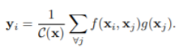
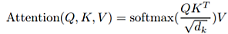
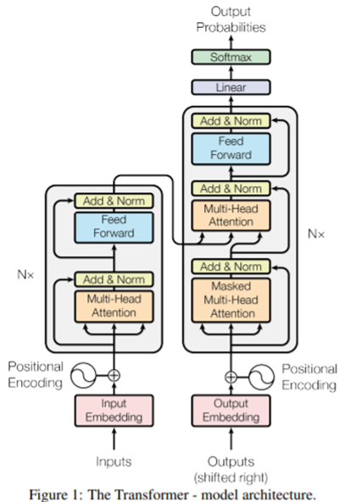
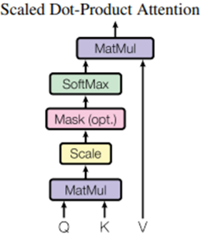
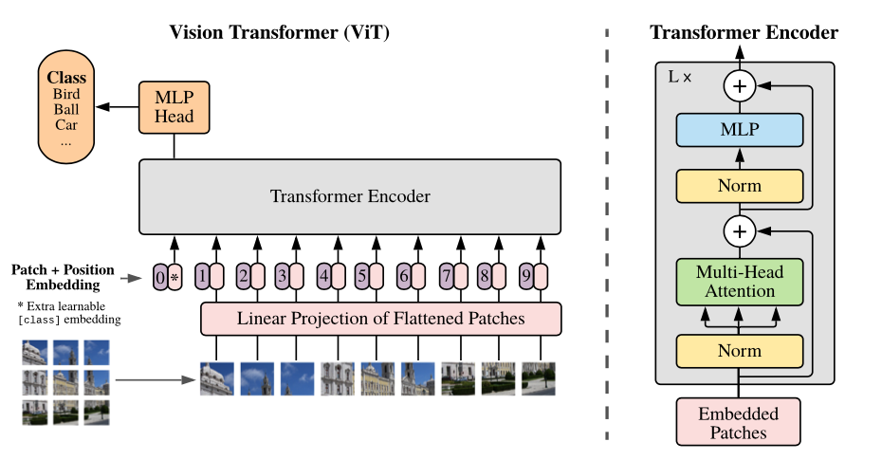

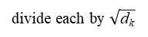

1.2.1 Related Works – Transformer (2/4)??
= as softmax()
Transformer
Non-Local NN
=V
3. Global Framework:
Transformer: an encoder-decoder structure.
Transformer using (1) stacked self-attention and point-wise,
(2) fully connected layers for both the encoder and decoder.
Employ residual connections around each of the sub-layers, followed by layer normalization
The encoder composed of stack of N=6 identical layers: each layer has two sub-layers.
1) a multi-head self-attention mechanism.
2) a simple, position-wise fully connected feed-forward network.
The decoder composed of stack of N=6 identical layers: each layer third sub-layer.
1) Masked multi-head attention - Self-attention sub-layer: prevent positions from attending to subsequent positions.
2) performs multi-head attention over the output of the encoder stack.
3) a simple, position-wise fully connected feed-forward network.
Normalize the attention weight to 0~1
Softmax()=weights of V
y_{i}
α₁,_{i i=1, 2,…I}
$$\hat{α\text{1}\text{,}\text{i}}$$
position
scaling factor
pixel-wise self-attention similarity weight
Y=(y₁, ..., y_{m})
(1x1 convolution)
Normalize the attention weight to 0~1
outputs of dimension d_{model} = 512.
Z= (z₁, ..., z_{n=512}).
Not MLP:
Softmax()=weights of V
feed-forward network with a single hidden layer. Cross channel process
➔ ?? (1x1x#ch)x#filters + ReLU +
(1x1x#ch)x#filters
N = 6 x identical layers
position
y_{i}
α₁,_{i i=1, 2,…I}
Layer Norm
$$\hat{α\text{1}\text{,}\text{i}}$$
pixel-wise self-attention similarity weight
scaling factor
Self-
K
Q
2) position-wise fully connected feed-forward network
Not MLP
V
=QKV Self-Attention
position
Decoder
y_{i}
z
residual connections
Encoder
Layer Norm
Regularization by using dropout the residual connection
residual connection
Mask: Related to Q
Normalize the attention weight to 0~1
pixel-wise self-attention similarity weight
y➔W*y
f(x_{i},x_{j})=
Self-
Self-
1) multi-head self-attention (MSA) mechanism.
Q
K
V
Q
K
V
Mask: Only for decoder
J: Limit its attention region, like center pixel with Gaussian distribution mask
position
x
position
Transformer Encoder/Decoder:
這兩個的設計概念是一樣的
MLP: FC+GELU+FC
Reduce dim
divide each by $\sqrt{\text{d}\text{k} }$
Consider geometric
position/distance information.
= same para =
dot products
Q: position
Previous decoder output layer
Input:
X= (x₁, ..., x_{n=512})
dimension d_{k}
d_{v}
Query Q
Key K
Value V

Slide 10
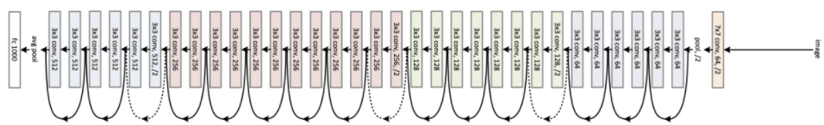
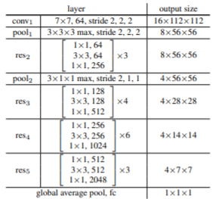
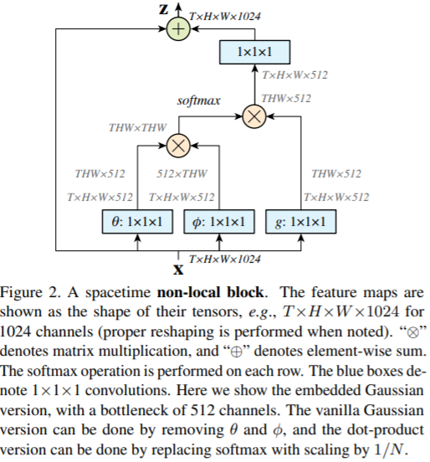
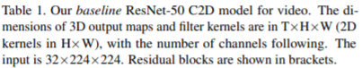

1.2.1 Related Works: Transformer - QKV Self-Attention (3/4)
Non-Local NN ??
= as softmax()
Non-Local NN
=V
Non-local Neural Network, CVPR2018
Normalize the attention weight to 0~1
Softmax()=weights of V
y_{i}
α₁,_{i i=1, 2,…I}
$$\hat{α\text{1}\text{,}\text{i}}$$
non-local block
position
pixel-wise self-attention similarity weight
scaling factor
Input video: 224x224x32
res2: 112x112
res3: 56x56
res4: 28x28
res5: 14x14
I/P: 32x224x224
Non-local block +identity function
T = # frames input??
TxHxWx512??
W_{z} y_{i}
Add & Norm:
X’=LayerNorm(X + Sublayer(X))
f(x_{i},x_{j})=
Linear transformation
y_{i}
Norm
y_{i}
as
pixel-wise self-attention similarity weight
f(x_{i},x_{j})=
$$\hat{α\text{1}\text{,}\text{i}}$$
Residual connection
α₁,_{i i=1, 2,…I}
Linear transformation
Q: position
φ(x_{j} ) = W_{φ}x_{j}
g(x_{j} ) = W_{g}x_{j}
θ(x_{i}) = W_{θ}x_{i}
Q: position
Key K
Value V
Query Q
Non-local block + identity function

Slide 11
1.2.1 Related Works: Transformer - QKV Self-Attention (4/4)
Non-Local NN ??
= as softmax()
Non-Local NN
=V
Non-local Neural Network, CVPR2018
Normalize the attention weight to 0~1
Softmax()=weights of V
y_{i}
α₁,_{i i=1, 2,…I}
$$\hat{α\text{1}\text{,}\text{i}}$$
position
pixel-wise self-attention similarity weight
scaling factor
Layer Norm
Normalize the attention weight to 0~1
Non-local block +identity function
Softmax()=weights of V
position
y_{i}
T = # frames input??
pixel-wise self-attention similarity weight
y_{i}
TxHxWx512??
scaling factor
Add & Norm:
X’=LayerNorm(X + Sublayer(X))
W_{z} y_{i}
=QKV Self-Attention
f(x_{i},x_{j})=
y_{i}
y_{i}
Normalize the attention weight to 0~1
pixel-wise self-attention similarity weight
as
pixel-wise self-attention similarity weight
f(x_{i},x_{j})=
$$\hat{α\text{1}\text{,}\text{i}}$$
Self-
f(x_{i},x_{j})=
$$\hat{α\text{1}\text{,}\text{i}}$$
Residual connection
Mask: Only for decoder
J: Limit its attention region, like center pixel with Gaussian distribution mask
MSA
α₁,_{i i=1, 2,…I}
α₁,_{i i=1, 2,…I}
divide each by $\sqrt{\text{d}\text{k} }$
dot products
Q: position
φ(x_{j} ) = W_{φ}x_{j}
g(x_{j} ) = W_{g}x_{j}
θ(x_{i}) = W_{θ}x_{i}
Key K
Value V
Query Q
Input:
Q: position
dimension d_{k}
d_{v}
x_{i}
Non-local block + identity function
Query Q
Key K
Value V

Slide 12
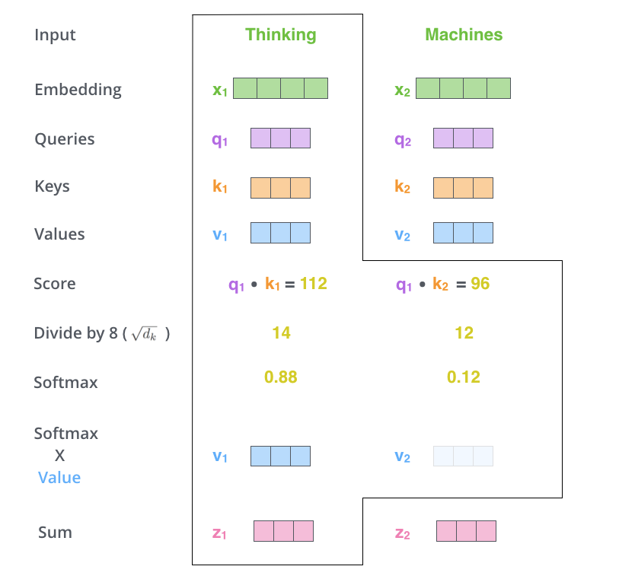
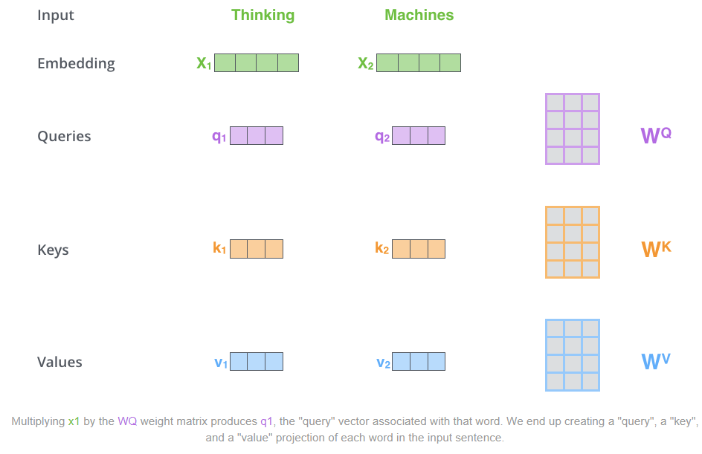
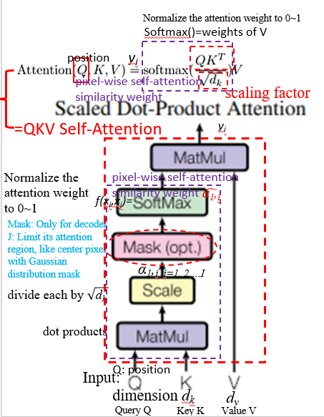
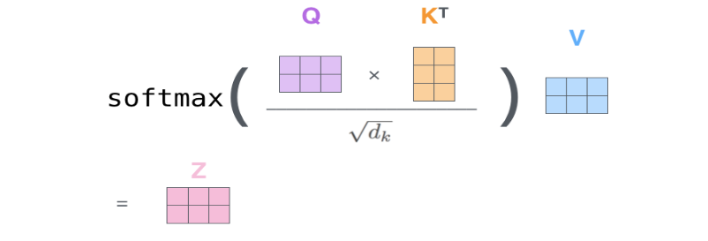
1.2.1-1 Attention Mechanism: Single Attention (1/2)
y_{i}
$Attention\left(Q,K,V\right)=softmax\left(\frac{QK^{T}}{\sqrt{d_{k}}}\right)V$ , $\sqrt{d_{k}}$ 用於限縮結果範圍，避免過大
y_{i}
y₁
y₂
y_{i}
Notes:
The self-attention layer calculates attention weights for each pixel in the image based on its relationship with all other pixels, while the feed-forward layer applies a non-linear transformation to the output of the self-attention layer
Read more at: https://viso.ai/deep-learning/vision-transformer-vit/
https://www.v7labs.com/blog/vision-transformer-guide

Slide 13
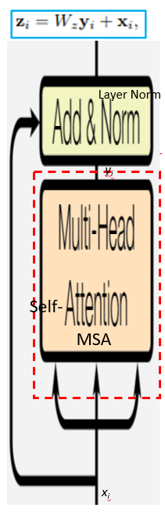

1.2.1-2 Attention Mechanism: Single Attention (2/2)

Slide 14
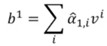
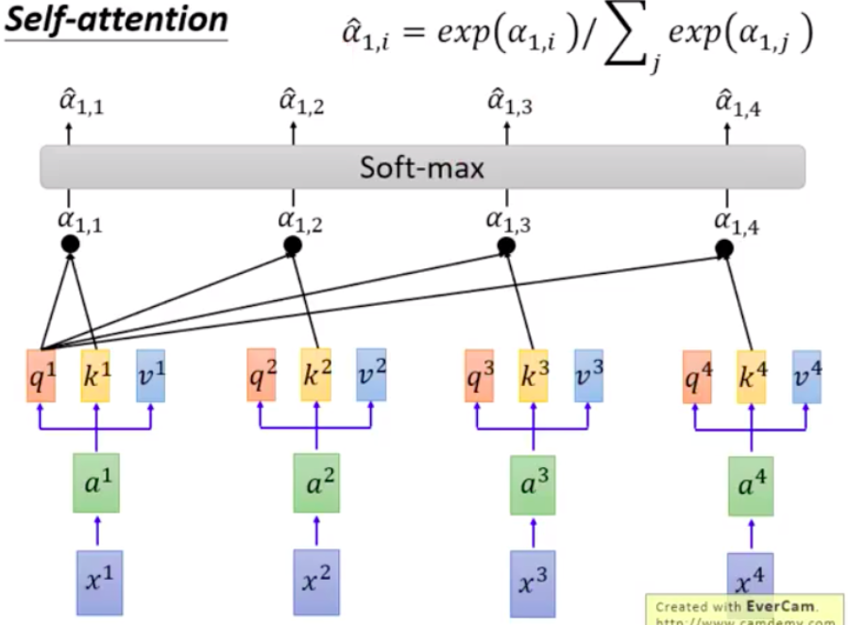
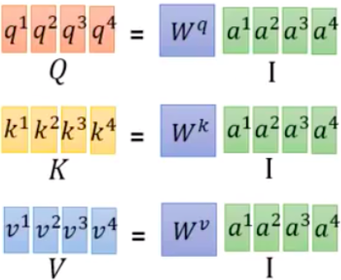
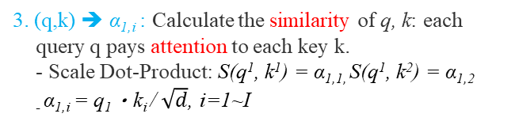
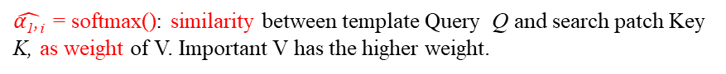
1.2.1-2 Attention Mechanism: ?? Single Attention (1/2)
F: -Why? Create the K, Q, V for each word or pixel by linear transformation (1x1 convolution).
Because the same word has a different meaning in the different combinations.
Self-Attention Layer:
Key
Three elements <Q, K, V>: represents attention mechanism.
The similarity between Query Q and Key K, and assigns the value of Value V according to the similarity.
Definition of Attention formula:
Ex: a sentence consists of 4 Words: It is my dog.
Q: current word or pixel
K: the other 3 words or neighbor pixels
d_{k} : the dimension of q and k
Query
Value
Q: position
y_{i}
α₁,_{i i=1, 2,…I}
$$\hat{α\text{1}\text{,}\text{i}}$$
where V= word in the sentence or the pixel at the image
Pixel-wise self-attention similarity weight
: the dimensions of q and k
Pixel-wise self-attention similarity weight of pixel value V:
$\hat{α\text{1}\text{,}\text{i}}$ = softmax(): similarity between template Query Q and search patch Key K, as weight of V. Important V has the higher weight.
O/P
Pixel-wise self-attention similarity weight
4. (q,k) ➔ α_{1,i} ➔ $\hat{α\text{1}\text{,}\text{i}}$ : Output the attention Weight $\hat{α\text{1}\text{,}\text{i}}$ = softmax()
y_{i} =
- Soft-max: Normalizing the α₁,_{i ,} 0 < α₁,_{i} <1
3. (q,k) ➔ α_{1,i} : Calculate the similarity of q, k: each query q pays attention to each key k.
- Scale Dot-Product: S(q¹, k¹) = α_{1,1,} S(q¹, k²) = α_{1,2}
₋ α_{1,i} = q₁・k_{i} / $\sqrt{d}$, i=1~I
Cross-attention
2. a➔(q,k,v): Each a^{i} input is multiplied by a different vector: q, k, v
q: query (self as template,
為了去匹配其他人)
- q^{i}=W_{q} a^{i}
(2) k: key (as patch within search region
為了被匹配)
⁻ k^{i}=W_{k} a^{i}
(3) V: value (被抽取出來的資訊)
- v^{i}=W_{v} a^{i}
Weight (W_{q}/ W_{k}/ W_{v}) is trained and initialized randomly.
Q: position
Q: position
θ(x_{i}) = W_{θ}x_{i}
φ(x_{j} ) = W_{φ}x_{j}
g(x_{j} ) = W_{g}x_{j}
J: 1x1 spatial conv
as weight w_{q1}, w_{k1}, w_{v1}
1x1 spatial conv
as weight w_{q2}, w_{k2}, w_{v2}
1. x➔a: The input sequence multiplied by a ?? weight matrix to become: a¹,a²,a³,…,a⁴
J: 1x1 spatial conv as weight w
input: x¹, x²,.., x⁴
Word of sentence or
Pixel of image:

Slide 15
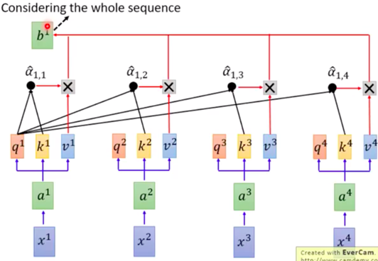
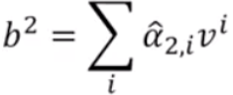
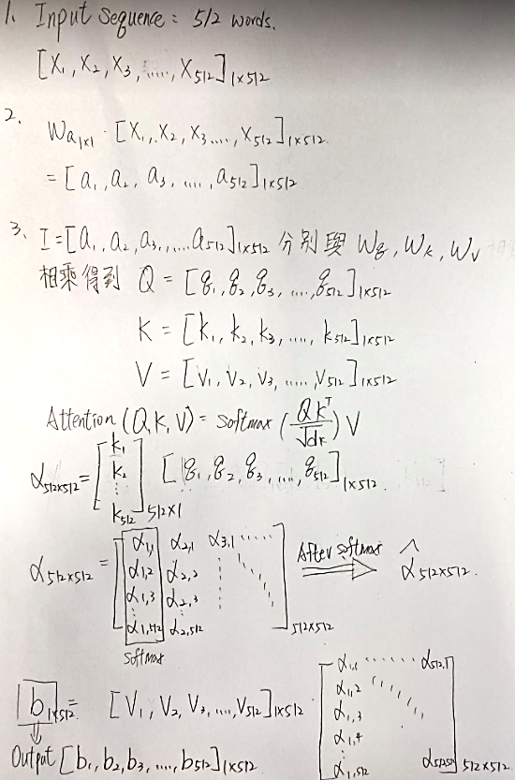
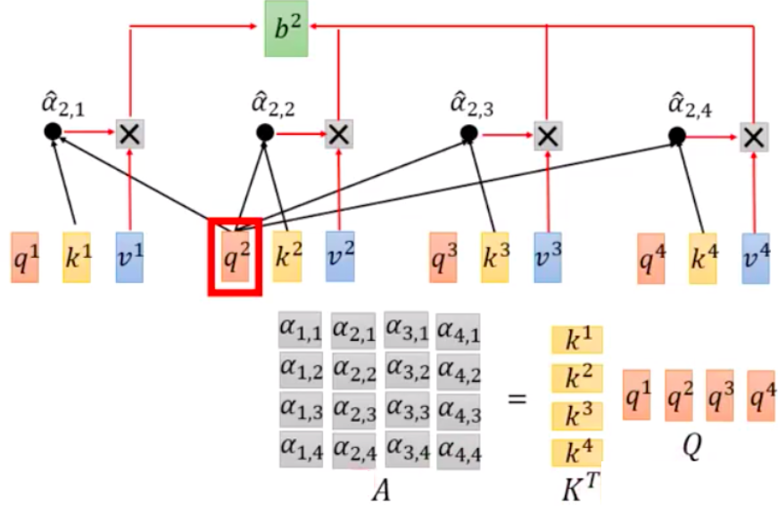
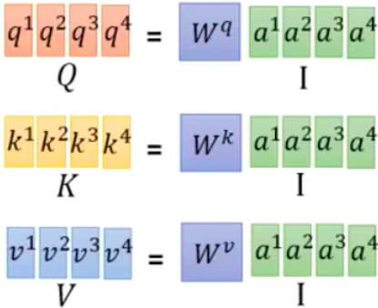
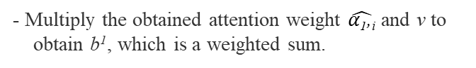
1.2.1-2 Attention Mechanism: Single Attention (2/2) ??
F: Enhance information form all elements by Q K correlation matrix as similarity weight to V
Correlation: enhance the similar elements
Self-Attention Layer:
y_{i} =
O/P
5. The final output size is same as the input sequence.
b¹: the first vector (word or character) of the requested sequence.
y_{i} =
Cross-attention
b as Natural Language
- Multiply the obtained attention weight $\hat{α\text{1}\text{,}\text{i}}$ and v to obtain b¹, which is a weighted sum.
Self-attention parallel processing
1x1 conv
?? W(512x512) diagonal matrix
a = W x
1x1 conv
y_{i} =
Q: position
θ(x_{i}) = W_{θ}x_{i}
φ(x_{j} ) = W_{φ}x_{j}
Cross-attention
$$\hat{α\text{1}\text{,}\text{i}}$$
α₁,_{i i=1, 2,…I}
g(x_{j} ) = W_{g}x_{j}
as NL
?? 好像寫反了 1,1; 1,2; …
Pixel-wise self-attention similarity weight
y_{i} =
Q: position
as NL
Converted to matrix multiplication: can use GPU to accelerate the calculation.
Pixel-wise self-attention similarity weight’
?? 好像寫反了
1,1; 1,2; …

Slide 16









1.2.2 Related Works: MSA
Attention Mechanism: Multi-Head Self-Attention (MSA)
MSA: 一組QKV可以想像成對應一種特徵，利用更多的QKV來表示多種特徵，類似在conv中，多個filter來萃取不同影像特徵的概念。
Multi-head self-attention layer: key words of sentence
Found it beneficial to linearly project the Q, K and V h times with different, learned linear projections to d_{q}, d_{k} and d_{v} dimensions.
Single attention function with d_{model}-dimensional K, V and Q.
Each head focuses on different information, some only care about local information, some only care about global information.
ex: 2-head self-attention:
1) Split q, k, v into two q, k, v: q_{i,1} only be multiplied by k_{i,1} to get α_{i,1} finally b_{i,1.}
2) Concate b_{i,1} , b_{i,2} together, multiply it by a transform, and do dimensionality reduction to get the final b_{i}.
=QKV Self-Attention
=Multi-Head Self-Attention (MSA)
y_{i} =
Multi-head attention: h=8
$$\hat{α\text{1}\text{,}\text{i}}$$
??
α₁,_{i i=1, 2,…I}
Q: position
Q: position
Q: position
Attention Visualization
Single-head
Multi-head
??
local
??
global
The relationship between the two words, the thicker line means the deeper the connection.
Different sets of q and k have different results and have different information.

Slide 17














1.2.2 Related Works: MSA
Attention Mechanism: Multi-Head Self-Attention (MSA)
$b^{i}$
MSA (Multi-Head Self-Attention Layer)
Linear Convolution
Attention head = 2
concatenate
$$b^{i,1},b^{i,2}$$
$$α_{ii,1}=q^{i,1}∙Transpose(k^{i,1})$$
y_{i} =
：矩陣乘常數
Sum
$b^{i,1}=$ Attention(Q,K,V)
= $Softmax\left(\frac{QK^{T}}{\sqrt{d}}+B\right)V$
：矩陣内積
Sum
Attention head = 2 = as feature maps
$$α_{ii,1}$$
$$α_{ij,1}$$
$$α_{ii,2}$$
$$α_{ij,2}$$
Attention(Q,K,V)
= $Softmax\left(\frac{QK^{T}}{\sqrt{d}}+B\right)V$
Attention head h = 2
Q ➔ All q
K ➔ All k
d ➔ scale factor (make variance from d to 1)
B ➔ learnable relative position (Bias or Bias = 0)
Input: $a^{i}, a^{j}$
W: Linear Convolution （Transform)
2 patches

Slide 18


1.2.3 Related Works [7] – ViT (1/3)
Vision Transformer (ViT) [7]
Transformer Layer Module (TLM)
TLM block
3. Head: Image Classification Using MLP Head (FC Layer)
1) Only Class Vector is taken to do this - classification.
J: Spatial:
Fully connected network for further extraction as pixel-wise convolution.
Class Vector
MLP: FC+GELU+FC
Dimension Transfer
2. Encoder: Feature Extraction in Transformer Encoder
Layer Norm
Patch = 256-dim vector (16x16 pixel)
Position of patch: (0,0), (1,0), …(2,2)
1.2
Patch
MSA:
Class Vector
Self-
Feature extraction
Reshape 2D to 1D
Layer Norm
H
16 pixels
1.1.2 Reshape, and Position and Class Embeddings: Preprocess patch images in embedded patched
1) Reshape 2D to 1D - Flatten Patch Images, Project 256-dim vector (16x16) to shorter vector and
2) Position Embedding: to each Vector Before Input to Transformer Encoder
3) One Class Vector Embedding: is added only to be taken to MLP/FC Layer for Classification after transformer encoder
$$I_{o}$$
16 pixels
W
Information about patch geo. position
1.1.1 Tokenize: Separate image to (PxP-pixel) patches, P=16
Problem of ViT:
1) The number of patch depend on the size of the image and the patch.
- Ex: Image size= 256x256 , Patch size= 16x16 pixels ➔ Patch number = 16
Image size= 1264x1264 , Patch size= 16x16 pixels ➔ Patch number = 79
2) To extract smaller feature of input image, we need smaller size patches. Which mean increase the patch number.
Q: Too many patches will need more calculation time and memory on transformer.
Notes:
There are two main approaches to exploiting global context
information:
the encoder-decoder architecture and
Pyramid pooling.

Slide 19

1.2.3 Related Works [7] – ViT (2/3)
Transformer Layer Module (TLM)
TLM block

Slide 20













1.2.3 Related Works: ViT (3/3)
1.5 Output Grasp Pose Map $G=(Φ,W,Q)$ Using Projection Layer (1x1x96c)x1 filter
(Explain in 3.2)
Q
$$θ$$
W
$$HxWx1c$$
$$HxWx1c$$
$$HxWx1c$$
4) Head:
Project the HxWx96 feature map to Quality (Q), Cos(angle), Sin(angle)
$$\frac{H}{4}x\frac{W}{4}x96c$$
3) Decoder:
Feature Extraction Using Swin Transformer +
Upsampling Using Patch Expanding
concatenate
- Upsampling Using Stacked Transformer Layers (Swin Transformer) and Patch Expanding (Upsampling)
K=4
2) Encoder:
Feature Extraction using Swin Transformer +
Downsampling Using Patch Merging
K=4
- Downsampling Using Stacked Transformer Layer (Swin Transformer) and Patch Merging (Downsampling)
Position Embedding??
$$\frac{H}{4}x\frac{W}{4}x 96c$$
1) Tokenize, Reshape Embedding:
Tokenize image to 4x4 patches (token) and reshape 2D to 1D with higher dimension
$$\text{160}\text{x}\text{120}x(96c)$$
(E: Embedding vector dim.)
(1x1x48C)x96filter
(3) Embedding Layer (Projection to fixed-dim)
(Linear transform)
(1) Cut Image into Non-overlapping (P x P) Patches.
Each patch size : 4x4x3(RGB)c (P = 4)
$$\text{160}\text{x}\text{120}x\left(48\right)c$$
(2) Patches Flattening (Reshape 2D➔1D)
reshape=48c
$$\text{160}\text{x}\text{120}x\left(4x4x3\right)c$$
(1) Patch Partition Layer (Token)
(2) Preprocess input image from 4x4x3c 2D Patches to token 1x1x48c and to 1x1x96c 1D Pixel Vector using linear projection of flatten patch
$I_{p}$:
P=4
($160x120$) patches x (4x4x3c) per patch➔ ($\frac{H}{P}x\frac{W}{P}$) total patches of $I_{o}$
P=4
0) Input RGB Image
P=4
P=4
$$I_{0}$$
H = 640
HxWx3c
W = 480
Fig. 1. Overview of the TF-grasp model. Our model takes as input the image captured by the camera mounted on the end-effector of the manipulator and generates a pixel-level grasp representation.
Notes:
Eye in hand and eye to hand 的矯正

Slide 21




1.2.3-1 Related Works: ViT - Transformer Encoder ??
??
Dimension Transfer
MLP: FC+GELU+FC
Feature extraction
對於Encoder的第l層，記其輸入為$z_{l−1}，$輸出為$z_{l}。$
$$z_{0}:Encoder first input$$
$X_{p}^{1},….,X_{p}^{N}: 還未$Linear Projection的patch embedding(都是$P^{2}C$ 維)
$X_{p}^{1}E,….,X_{p}^{N}E:經過$E做linear projection ，使每個patch的維度都是D維
$$E_{pose}:postion Embedding$$
$$LN:Layer Normalization$$
Notes:
The self-attention layer calculates attention weights for each pixel in the image based on its relationship with all other pixels, while the feed-forward layer applies a non-linear transformation to the output of the self-attention layer
Read more at: https://viso.ai/deep-learning/vision-transformer-vit/
https://www.v7labs.com/blog/vision-transformer-guide

Slide 22


1.2.3-1 Related Works: ViT - Transformer Encoder – MLP Vs. FFN ??
Multi-Layer Perceptron(MLP) Vs. FFN VitPose Cvpr2022
??
Feedforward Neural Network: (FFN)
資料經由輸入層通過隱藏層(hidden layer)到輸出層單向傳播，神經元(neuron)之間沒有連接迴路存在, Not fully connected layer
MLP: FC+GELU+FC
Dimension Transfer
Feature extraction
Multi-Layer Perceptron (MLP)
A multilayer perceptron is a special case of a feedforward neural network where every layer is a fully connected layer.
Notes:
The self-attention layer calculates attention weights for each pixel in the image based on its relationship with all other pixels, while the feed-forward layer applies a non-linear transformation to the output of the self-attention layer
Read more at: https://viso.ai/deep-learning/vision-transformer-vit/
https://www.v7labs.com/blog/vision-transformer-guide

Slide 23






1.2.4 Related Works: Swin Transformer [8] (1/3-1/2-1/2)??
Q: Too many patches will need more calculation time and memory on transformer
A: Swin Transformer
後面會加上 FC/MLP 來進行分類
(或可當成 R-CNN的 Backbone)
Transformer Layer Module (TLM)
0) Tonkenize Input
1) Encoder
TLM block
MLP: FC+GELU+FC
MLP: FC+GELU+FC
W
Reshape 2D to 1D
1. Resize the Image from HxWx3 to $\frac{H}{4}x\frac{W}{4}x 48c$
2. Feature Extract
C=96 (Can be changed the model size)
邦尉：一定會做二被數次，(2,4,6,8 次)
第一次做W-MSA
第二次做SW-MSA
To solve the problem of ViT, Swin Transformer propose shifted windows.
Instead of input a whole image to MSA (Window-Multiple-Head Self Attention), a fix number NxN of smaller patch (2x2 pixels, 4x4 pixels) (which formed into one window) is input to MSA multiple times.
(So the input of the MSA layer will be smaller)
To extract the info between two window, author purpose Swin Transformer Block:
SW-MSA
$\frac{N}{2}$
Shifted window
第二次做SW-MSA：
To avoid non-overlapped missing information problem
$\frac{N}{2}$
第一次做W-MSA：
Smaller patch size
W-MSA
$NxN=4x4$ patches
SW-MSA: Window Multiple-Head Self Attention
W-MSA: Shifted Window Multiple-Head Self Attention
M=2x2 windows
Notes:
There are two main approaches to exploiting global context
information:
the encoder-decoder architecture and
Pyramid pooling.

Slide 24




1.2.4 Related Works: Swin Transformer [8] (1/3-1/2-2/2)??
後面會加上 FC/MLP 來進行分類
(或可當成 R-CNN的 Backbone)
Transformer Layer Module (TLM)
Swin Transformer [8] (Swin Transformer Blocks)
MLP: FC+GELU+FC
MLP: FC+GELU+FC
W
Layer Norm
Reshape 2D to 1D
Layer Norm
Why MLP?? J: Because transformer has no convolution, so it uses MLP instead of convolution
Take many parameters
Transformer Layer Module (TLM)
MLP (Multilayer perceptron)
TLM block
2 Fully Connect Layer
W-MSA
add
add
MLP: FC+GELU+FC
Input
Output
$NxN$=4x4 patches
M=2x2 windows
MLP: FC+GELU+FC
MLP: FC+GELU+FC
SW-MSA
Shifted window
add
add
$\frac{N}{2}$
(1, d)
$\frac{N}{2}$
(1,d)
家銘：類似於做point-wise convolution，再萃取的功能
(1, 4d)
Layer normalize
LN : Layer Normalization
W-MSA: Window Multiple-Head Self Attention
SW-MSA: Shifted Window Multiple-Head Self Attention
Notes:
There are two main approaches to exploiting global context
information:
the encoder-decoder architecture and
Pyramid pooling.

Slide 25















1.2.4 Modified RGB-D Swin Transformer (1/3-2/2)
1) Get Quality (Q), Cos(angle), Sin(angle) using Swin Transformer
Q [0,1]
Cos [-1,1]
Sin [0,1]
$$\text{68}\text{0}\text{x}\text{480}x1c$$
$$\text{68}\text{0}\text{x}\text{480}x1c$$
$$\text{68}\text{0}\text{x}\text{480}x1c$$
4) Head:
Project the HxWx96 feature map to Quality (Q), Cos(angle), Sin(angle)
Conv (1x1x96c)x1c
Conv (1x1x96c)x1c
Conv (1x1x96c)x1c
$$\text{6}\text{8}\text{0}\text{x}\text{480}x96c$$
Upsampling x4
Patch Expand (Wx4,Hx4)
3) Decoder:
Feature Extraction Using Swin Transformer +
Upsampling Using Patch Expanding
$$\text{160}\text{x}\text{120}x96c$$
Swim Transformer Layer
x3
$$\text{160}\text{x}\text{120}x96c$$
Swim Transformer Layer + Patch Expanding
80x60x96c
x3
Swim Transformer Layer + Patch Expanding
…
shortcut
x3
Swim Transformer Layer + Patch Expanding
20x15x768c
x3
Swim Transformer Layer + Patch Expanding
10x15x768c
Upsampling
2.2) Fusion Layer:
(1) Concatenate + (2) (1x1x2c)x1c filters
(C+C)➔Fusion (C)
C+C➔C
C+C➔C
(1x1x2c)x1c filter
…
C+C➔C
2.1) Encoder:
Feature Extraction using Swin Transformer +
Downsampling Using Patch Merging
10x15x1526c
10x15x1526c
Swin Transformer
Swin Transformer
x3
10x15x1526c
10x15x1526c
Swin Transformer + Patch Merging
Swin Transformer + Patch Merging
x3
…
x3
…
Swin Transformer + Patch Merging
20x15x768c
Swin Transformer + Patch Merging
20x15x768c
x3
Swin Transformer + Patch Merging
…
x3
Swin Transformer + Patch Merging
…
x3
Swin Transformer + Patch Merging
x3
Swin Transformer + Patch Merging
80x60x192c
Position Embedding??
Downsampling
80x60x192c
Downsampling
1) Tokenize, and Reshape Embedding:
Tokenize image to 4x4 patches (token) and reshape 2D to 1D with higher dimension
$$\text{160}\text{x}\text{120}x(96c)$$
(E: Embedding vector dim. W)
(3) Embedding Layer W (Projection to fixed-dim)
(1x1x48C)x96filter
(3) Embedding Layer W (Projection to fixed-dim)
(1x1x48C)x96filter
$$\text{160}\text{x}\text{120}x\left(48\right)c$$
W: Linear Transformation
(2) Patches Flattening (Reshape 2D➔1D)
reshape=48c
(2) Patches Flattening (Reshape 2D➔1D)
(1) Patch Partition Layer (Token)
$$\text{160}\text{x}\text{120}x\left(4x4x3\right)c$$
(1) Patch Partition Layer (Token)
0) Input RGB+DDD Images
HxWx3c
$I_{RGB} 3 c$hannel
$$I_{D }3 channel$$
H = 640
H = 640
W = 480
W = 480

Slide 26




1.2.4 Related Works: Swin Transformer [8] (2/3)??
參考右圖
$\frac{N}{2}$
6. Swin Transformer (Masked MSA)
$\frac{N}{2}$
家銘：讓SW-MSA和W-MSA的做self-attention的方法一樣，只要做圖像的位移和mask找到要的結果就可以。
q
q
Transpose(k)
Transpose(k)
7,1
7,1
q
q
5,3
5,3
8,6
8,2
8,0
Transpose(k)
5,3
Transpose(k)
5,3
6,8
6,2
6,0
5,3
5,3
2,8
2,6
2,0
5,3
5,3
0,8
0,6
0,2
Diagonal is self-correlation, others are cross-correlation
White part is masked (will not be read) after multi-head self attention layer
Notes:
There are two main approaches to exploiting global context
information:
the encoder-decoder architecture and
Pyramid pooling.

Slide 27





1.2.3 Related Works [8]: Swin Transformer – Layer Normalization (3/3)
6. Swin Transformer [31] (Layer Normalization)
2) At current layer l:
- Conv(wxhxCh) x m filters
- Creates m feature maps
1) At previous layer l-1 as Input:
-Batch size N:
> One batch has C feature maps
- Ch feature maps, $Ch∈C$
Convolution with Multiple Filter m:
Set 1 batch has C dataset (C maps)
Batch Input:
- One batch has C feature maps
Batch 1
Batch normalization calculate mean and variance of all of the N batches output in one filter,
- One batch has C feature maps
Batch 2
Layer normalization calculate mean $μ$ and variance $σ$ of all of the m filters output in one batch
Batch N
Output (mean $μ$, variance $σ$)
Figure below visualize different types of normalization.
Instance Norm:
Only normalize each output image independently
Group Norm:
Only normalize pre-set amount (one group) of output image independently
H: Height
W: Width
C: Channel
N: Batch size
- One batch has C feature maps
1D HxW
Note: H,W is a 1D vector which flatten from 2D image
Notes:
There are two main approaches to exploiting global context
information:
the encoder-decoder architecture and
Pyramid pooling.

Slide 28







1.2.4-1 Token and Reshape: Patching (Tokenize) the Image and Linear Embedding (Projection)
(E: Embedding vector dim.)
1.1.3 Embedding Layer (Projection to fixed-dim):
Project the patch from 1x1x48 channel to
1x1x96 channel in Embedding Layer
1D
Linear Embedding (projection):
邦尉：可看成 (1x1x48c)x96filters
$$(160x120)x96c$$
($1x1x48c)x96 filter$
(3) Embedding Layer (Projection to fixed-dim)
(1x1x48C)x96filter
1.1.2 Patch Flattening (Reshape 2D ➔1D):
$All 4x4x3c 2D patch (token)$
flatten (reshape) to 1x1x48 1D channel
1D
$$(160x120)x48c$$
Reshape from 2D (4x4x3c) to 1D (48c)
(2) Patches Flattening (Reshape 2D➔1D)
1.1.1 Patch Partition (Token) Layer:
Cut image into Non-overlapping (P x P) Patches.
patch size (= Token): 4x4x3c (P = 4)
($160x120$) x(4x4x3c)
➔ ($\frac{H}{P}x\frac{W}{P}$) total patches (token) of $I_{o}$
$I_{p}$:
P=4
P=4
(1) Patch Partition Layer (Token)
640x480x3c
0. Input RGB+DDD Images
$$I_{RGB}$$
H = 640
W = 480
Notes:
Eye in hand and eye to hand 的矯正

Slide 29












1.2.4-2 Related Works: Swin Transformer [8]- Downsampling by Patch Merging ??
Swin Transformer [8]
Linear Embedding: 邦尉：可看成 (1x1x48c)x96filters
C=96
後面會加上 FC/MLP 來進行分類
(或可當成 R-CNN的 Backbone)
1. Resize the Image from HxWx3 to $\frac{H}{4}x\frac{W}{4}x 48c$
2. Feature Extract
Swin Transformer also propose patch merging to downsampling the feature map. (Will discuss in next page)
家銘：Patch merge 在每個stage之前進行downsampling，相比一般CNN downsampling使用convolution stride=2的方法可以省下計算量，同時又可以保留特徵
Patch Merging:
Reshape 1D ➔ 4D
Channel-wise Linear Transform
（1x1x4c）x2filters
J: 這個cross-over channel 的處理好像是pixel-wise 不是 channel-wise??
Rearrange
$$(\frac{H}{4}x\frac{W}{4})x 96c$$
$$(\frac{H}{4}x\frac{W}{4})x 96c$$
$$(\frac{H}{8}x\frac{W}{8})x (96cx2x2)$$
$$(\frac{H}{8}x\frac{W}{8})x (96cx2x2)$$
$$(\frac{H}{8}x\frac{W}{8})x (96cx2)$$
Notes:
There are two main approaches to exploiting global context
information:
the encoder-decoder architecture and
Pyramid pooling.

Slide 30





1.2.4-2 Patch Merging -Downsampling and Patch Expanding-Upsampling ??
J: 這個cross-over channel 的處理好像是pixel-wise 不是 channel-wise??
Channel-wise
Linear Transform
（1x1x4c)x2filters
1. Patch Merging for Downsampling:
Reshape 1D➔4D
Rearrange
$$(\frac{H}{4}x\frac{W}{4})x 96c$$
$$(\frac{H}{4}x\frac{W}{4})x 96c$$
$$(\frac{H}{8}x\frac{W}{8})x (96cx2x2)$$
$$(\frac{H}{8}x\frac{W}{8})x (96cx2x2)$$
$$(\frac{H}{8}x\frac{W}{8})x (96cx2)$$
2. Patch Expanding for Upsampling:
Channel-wise Linear Transform
(1x1x2c)x4filters
?? Do it does Layer norm??
Reshape 4D➔1D
Rearrange
($\frac{H}{8}x\frac{W}{8})x 2c$
($\frac{H}{8}x\frac{W}{8})x \left(2x2\right)c$
$$(\frac{H}{4}x\frac{W}{4})x 1c$$
($\frac{H}{4}x\frac{W}{4})x c$
邦尉：Channel-wise Linear 是等價于 1x1xC convolution ??
Ex: (Patch Merging) Channel-wise Linear == (1x1x4C)x2C filters
(Patch Expanding) Channel-wise Linear == (1x1x2C)x4C filters
Notes:
Eye in hand and eye to hand 的矯正

Slide 31

1.2.5 Related Works: Neighborhood Attention Transformer (NAT) arXiv2022 Introduction: Motivation & Objective
Motivation:
Higher image resolution results in a quadratic increase in complexity and memory usage in models strictly using self-attention, such as ViT.
2.2) Convolutions (neighborhood attention) benefit from inductive biases such as locality, translational equivariance, and 2-dimensional neighborhood structure,
2.1) while dot-product self attention is a global 1-dimensional operation by definition.
3) Local attention modules were therefore applied to alleviate this issue. Swin was one of the first hierarchical vision transformers based on local self attention.
Performing self attention using fix location attention windows and only shift windows once after passing through. Cause the receptive field imbalance (?? Swin problem??).
Objective:
The sliding-window pattern allows NA’s receptive field to grow without needing extra pixel shifts, and preserves translational equivariance, unlike Swin Transformer’s Window Self Attention (WSA).
銘：這篇主要是想跟Swin-Transformer來比較
q: query (self as template,
為了去匹配其他人)
- q^{i}=W_{q} a^{i}
(2) k: key (as patch within search region
為了被匹配)
⁻ k^{i}=W_{k} a^{i}
(3) V: value (被抽取出來的資訊)
- v^{i}=W_{v} a^{i}
Weight (W_{q}/ W_{k}/ W_{v}) is trained and initialized randomly.
1) dot-product self-attention: 1D, Global
THWx512d
THWx512d
THWx512d
THWx512d
dot-product
Pixel-wise self-attention similarity weight
THWxTHW
Figure 2. Illustration of the query-key-value (QKV) structure of Neighborhood Attention (NA) vs Self Attention (SA) for a single pixel.
SA allows each pixel to attend to every other pixel,
whereas NA localizes attention for each pixel to a neighborhood around itself.
Therefore, each pixel’s attention span is usually different from the next.
2) Convolutional neighbor attention: 2D, Locality
Conv.

Slide 32














1.2.5 Related Work - Neighborhood Attention Transformer (NAT) arXiv2022
??
1) dot-product self-attention: 1D, Global
Self attention:
THWx512d
THWx512d
$$Attention(Q,K,V)=softmax\left(\frac{QK^{t}}{\sqrt{d}}+B\right)V$$
THWx512d
THWx512d
dot-product
Neighborhood attention:
J: Global ??
$$NA_{k}\left(i\right)=softmax\left(\frac{A_{i}^{k}}{\sqrt{d}}\right)V_{i}^{k}$$
Pixel-wise self-attention similarity weight
J: Local ??
THWxTHW
2) Convolutional neighbor attention: 2D, Locality
${i+ρ}_{j}(i)$
𝑖
$$Q_{i}$$
$$A_{i}^{k}$$
$$V_{i}^{k}$$
dot product.
${i+ρ}_{j}(i)$
$$A_{i}^{k}$$
$$NA_{k}\left(i\right)$$
Q : Query
K : Key
V : Value
d : Embedded dimension
i : i-th token
k : Neighborhood (kernel) size
$ρ_{j}(i)$ : Token i’s j-th nearest neighbor value $j∈[1, k]$
B(i, j) : Bias of pixel (i, j)
T : Transverse
NAT Block:
N=3
DiNAT module 1
DiNAT module 2
DiNAT module 3
MLP: FC+GELU+FC
MLP: FC+GELU+FC
MLP: FC+GELU+FC
NAT Block:
N=3
Module 3
N=3
Module 2
Module 1

Slide 33





1.2.5 Related Works: Neighborhood Attention Transformer (NAT) arXiv2022 Introduction: Global Framework
0. Input
1. Encoder
2. Head using FC Layer
224 x 224
56 x 56
28 x 28
14 x 14
7 x 7
(1x1xP)
x1000
$$N_{1}=3$$
$$N_{2}=4$$
$$N_{3}=18$$
$$N_{4}=5$$
NAT embeds inputs using (3×3×1c) × 2c filters convolutions with 2 × 2, resulting in a spatial size 1/4th the size of the input.
Exist overlapping because kernel size is 3, but stride is 2 ??
銘： instead of 2 × 2 non-overlapping convolutions that Swin uses (patch merge).
銘：類似於convolution的概念，只和周圍的區塊算attetion
Figure 5. An overview of our model, NAT, with its hierarchical design.
- The model starts off with a convolutional downsampler, then moves on to 4 sequential levels, each consisting of multiple NAT Blocks, which are transformer-like encoder layers.
-Each layer is comprised of a multi-headed neighborhood attention (NA), a multi-layered perceptron (MLP), Layer Norm (LN) before each module, and skip connections.
-Between the levels, feature maps are downsampled to half their spatial size, while their depth is doubled.
➔ This allows for easier transfer to downstream tasks through feature pyramids.
NAT module

Slide 34

1.2.5 Related Works: Neighborhood Attention Transformer (NAT) arXiv2022
Figure 1. An illustration of attention spans in Self Attention, Shifted Window Self Attention, and our Neighborhood Attention.
1）Self Attention allows each token to attend to everything.
2.1）Window Self Attention divides self attention into non-overlapping sub-windows,
2.2) and is followed by Shifted Window Self Attention, which allows for out-of-window interactions that are necessary to receptive field expansion.
3) Neighborhood Attention localizes attention to a neighborhood around each token, introducing local inductive biases, maintaining translational equivariance, and allowing receptive field growth without needing extra operations

Slide 35

1.2.5 Related Works: Neighborhood Attention Transformer (NAT) arXiv2022
W-MSA
$NxN$ patches
SW-MSA
Shifted window
$\frac{N}{2}$
$\frac{N}{2}$
因爲每個pixel 都會shift window,
不需要多一個SW-MSA
MLP: FC+GELU+FC
Window size

Slide 36



1.2.5-1 NAT: Multi-Head Self-Attention (MSA) Vs. CNN Iclr2020
Self-Attention: 如果我們今天用 self-attention 來處理一張圖片一個 pixel 產生 query，其他的 pixel 產生 key。在進行 inner product 時候不是考慮一個小的區域而是整張的資訊。
而CNN: 因convolution，所以會畫出一個 receptive field 每一個 filter 只考慮 receptive field 範圍裡面的資訊
q: query (self as template,
為了去匹配其他人)
- q^{i}=W_{q} a^{i}
(2) k: key (as patch within search region
為了被匹配)
⁻ k^{i}=W_{k} a^{i}
(3) V: value (被抽取出來的資訊)
- v^{i}=W_{v} a^{i}
Weight (W_{q}/ W_{k}/ W_{v}) is trained and initialized randomly.
Q: position
Q: position
Notes:
https://andy6804tw.github.io/2021/05/03/ntu-multi-head-self-attention/#self-attention-%E8%88%87-cnn-%E6%AF%94%E8%BC%83

Slide 37
1.2.6 Related Works:??
Efficient Coarse-to-Fine Non-Local Module for the Detection of Small Objects
arXiv 2019

Slide 38
















1.2.7 Related Works: Super-Resolution
1) Hybrid Attention Transformer (HAT), 2) Overlapping Cross-Attention Block (OCAB)
Pixel shuffle: https://www.cnblogs.com/kk17/p/10094160.html
Activating More Pixels in Image Super-Resolution Transformer, CVPR 2023
To up-sample the fused feature
L1 loss to optimize the network parameters
(16x16)x(1536C)
1. Shallow Feature Extraction Using First conv3x3x3C
2. Deep Feature Extraction Using 6 RHAGs and Hconv
3. Image Reconstruction Using Pixel-Shuffle
$$L1(I_{SR,}I_{GT})\sum_{i=0}^{m}{{\left\|I_{SR}−I_{HR(GT)}\right\|}_{1}}$$
Recovering lost high-frequencies
Without downsampling
再加一層Conv層，能夠將捲積操作的歸納偏置(inductive bias)帶入這類基於Transformer骨架的網絡中，為後續淺層和深層特徵的融合打好基礎
DF2K Dataset
2D 64x64x96C
Upsampling x (r=2)
contain low-frequencies
- Focus on recovering lost high-frequency information
PixelShuffle(2)
?? Sum (96+96)=96C
F₀ ∈ R^{H×W×C}
F₀ +F_{D} ∈ R^{H×W×C}
F₀ Feature size: 64x64x96C- 2D
F_{D} ∈ R^{H×W×C}
I_{SR} : 128x128x3C
L1 loss
I_{LR} : 64x64x3C
(1) Reshape
(2) Reshape
2D 64x64x96C
2D 64x64x192C
Conv: (3x3x3C)x96 filters
Hconv (3x3x6144C)x96
Conv(3x3x192C)x64
Conv(3x3x16C)x3
RHAG number set to 6
(64x64)x(64x96C)
??
(rxr)x3=12c??
low frequency information
??
(64x64)x(96C)
– 1D
2. Deep Feature Extraction Using 6 RHAGs _1 block of RHAG
Feature size: 64x64x6144C ?? 96C
I_{HR(GT)} : 128x128x3C
(1) Patch Partition Layer (Token)
(1) Token and Reshape 2D➔1D: Split image into non-overlapping patches Using Patch Embedding
(64x64)x(96C)
(2) Reshape 1D➔2D: Merge non-overlapping patches into image Using Patch Unembedding
(2) Patches Flattening (Reshape 3D➔1D)
Do patching (Tokenize) the Image and Linear Embedding
conv (3x3x192C)x96
??
Restore the patch resolution (1D) to the original size of the 2D feature map
Patch size (Token): 1x1x96C P=1
(64x64)x(96C)
(64x64)x(2x96C)
(3) Embedding Layer (Projection to fixed-dim)
??
Number Patches : (64x64)=4096 Patches
(64x64)x(96C)
Patch size(Token): 1x1x96C P=1
Split image into non-overlapping patches Using Patch Embedding
$(\frac{H}{P}x\frac{W}{P}$)
$(\frac{H}{P}x\frac{W}{P}$)
(Reshape 2D ➔1D)
Number Patches : (64x64)=4096 Patches
Patches resolution - embedding: (64x64)x(96C) -1D
HAB number set to 6
Feature map resolution : 64x64x6144C??96 1D➔2D
patches
Patch size
6 HABs_ 1 block of HAB Using CAB, W-MSA, MLP
(1x1)x(96C) ➔copy➔ (64x64)x(96c)
Multi-Layer Perceptron
1) Downsampling Using Patches merging
2) Merge non-overlapping patches into image Using Patch Unembedding 1D➔2D
$α$
Y
??
(32x32)x(192C)
??
32x32x192C
(64x64)x(96C)
X_{N}
(64x64)x(96C)
(64x64)x(96C)
Channel Attention Block
1-$α$
X_{M}
QKV
(64x64)x(96C)
MLP:
FC
Overlapping Cross-Attention Block (OCAB)
Using OCA and MLP
window-based multi-head self-attention
FC
GELU
$γ$= 0.5 Control the overlapping size
Patch position correlation matrix
- Attention head number: 6
- M=2x2 windows
- Window size: 4x4 patches
- X_{N} = LN(X)
- X_{M} = (S)W-MSA(X_{N} ) + αCAB(X_{N} ) + X
- Y = MLP(LN(X_{M})) + X_{M}
MSA (Multi-Head Self Attention Layer)
- $α$=0.01
W-MSA
Q ➔ All q
K ➔ All k
d ➔ scale factor (make variance from d to 1)
B ➔ learnable relative position (Bias or Bias = 0)
𝛼: Weighting factor
$NxN$ patches
(64x64)x(96C)
(64x64)x(96C)
Channel Attention Block (CAB)
M=2x2 windows
QKV
Attention(Q, K, V )
= SoftMax(QK^{T} / $\sqrt{\text{d}}$ + B)V
Global Pooling: 1x1xC
(64x64)x(32C)
- Attention head number: 6
- Window size: 4x4 patches
GeLU
ReLU
(64x64)x(32C)➔(64x64)x(96C)
SW-MSA
- The overlapping window partition for OCA
(64x64)x(32C)
(1x1)x(32C)
$\frac{N}{2}$
Attention(Q, K, V )
= SoftMax(QK^{T} / $\sqrt{\text{d}}$ + B)V
(64x64)x(96C)
Conv1x1xC
Ch. weight
$\frac{N}{2}$
3x3xC/β
3x3xC
Conv1x1xC
β = 3
channel-wise features
β: Compress ratio
Shifted window
Figure 4. The overall architecture of HAT and the structure of RHAG and HAB.

Slide 39
1.2.7-1 Related Works: HAB – SW-MSA Vs. W-MSA Vs. NAT ??
2) HAB – W-MSA: window-based multi-head self-attention (W-MSA)
(5) SW-MSA vs. W-MSA (vs. NAT)
- The main difference is the different window splitting strategies
SW-MSA: uses non-overlapping local windows to segment feature maps and computes self-attention within each local window.
a.1) This method can help the model better capture local details,
a.2) but may ignore the relationship between different regions.
b) W-MSA: 相比之下，W-MSA 使用重疊的局部窗口對特徵圖進行分割，並在每個局部窗口內計算自注意力。
b.1) 這種方法可以增加特徵圖的覆蓋率，從而更好地捕捉不同區域之間的關係。
b.2) 然而，在某些情況下，重疊的局部窗口可能會導致一些阻塞伪影問題。
c) Conclusion: 因此，在實際應用中，需要根據具體任務和數據集來選擇適當的窗口分割策略。
c.1) 如果需要更好地捕捉局部細節信息，可以考慮使用SW-MSA；
c.2) 如果需要更好地捕捉不同區域之間的關係，可以考慮使用W-MSA。
HAT模型在不同情況下使用了SW-MSA（Shifted Window-based Multi-head Self-Attention）和W-MSA（Window-based Multi-head Self-Attention）。
具體來說，在HAT模型中，SW-MSA和W-MSA分別用於不同的變體。SW-MSA用於HAT-L（大型變體），而W-MSA用於HAT-S（小型變體）。
在HAT-L中: 作者通過將RHAG數量從6增加到12來擴大HAT的深度。
在這種情況下，SW-MSA被用於實現視窗大小為16×16的自注意力機制。
b) 而在HAT-S中: 為了減少參數數量並保持與SwinIR模型類似的計算量，作者提供了一個小型版本的HAT。
在HAT-S中，窗口大小為16×16的自注意力機制使用W-MSA實現。
因此，HAT模型根據其變體的不同選擇使用SW-MSA或W-MSA來實現視窗大小為16×16的自注意力機制。
??

Slide 40


1.2.7-2 Related Works: HAB – Overlapping Cross-Attention Block (OCAB)
1. Overlapping Cross-Attention Block(OCAB) is $H_{\operatorname{OCAB}{i}}$
1) OCAB: To directly establish cross-window connections and enhance the ability for the window self-attention.
OCAB consists of an overlapping cross-attention (OCA) layer and an MLP layer similar to the standard Swin Transformer block
OCA: As depicted in Fig. 5, use different window sizes to partition the projected features
2) OCA Window Partition X_{Q}, X_{K}, X_{V} ∈ R^{H×W×C} of the input feature X
X_{Q}: Partitioned into HxW/M² non-overlapping windows of size M × M, standard window partition
- The standard window partition: A sliding partition with the kernel size and the stride both equal to the window size M
X_{K}, X_{V}: Unfolded to HxW/M² overlapping windows of size Mo × Mo
- Overlapping window partition: Viewed as a sliding partition with the kernel size= Mo, while the stride= M
- Zero-padding= size (γ x M)/2 is used to ensure the size consistency of overlapping windows
Mo = (1 + γ) × M
γ= 0.5 a constant to control the overlapping size
Stride= M
Figure 5. The overlapping window partition for OCA.

Slide 41

1.2.7-2 Related Works: HAB – Overlapping Cross-Attention Block (OCAB)
3) OCA Window Attention X_{Q}, X_{K}, X_{V} ∈ R^{H×W×C} of the input feature X
Attention(Q, K, V ) = SoftMax((QK^{T} / $\sqrt{\text{d}}$ )+ B)V
- Relative position bias B ∈ R^{M×Mo} is also adopted
2. OCA vs. W-MSA
MSA: query, key and value are calculated from the same window feature
OCA: computes key/value from a larger field where more useful information can be utilized for the query (OCA computes cross-attention inside each window feature using pixel token)
Q ➔ All q, K ➔ All k,
d ➔ scale factor (make variance from d to 1)
B ➔ learnable relative position (Bias or Bias = 0)
Figure 5. The overlapping window partition for OCA.

Slide 42

1.2.8 TSMixer (Time-Series Mixer) (1/2)
TSMixer: An All-MLP Architecture for Time Series Forecasting
Published in Transactions on Machine Learning Research (09/2023)
Temporal Projection and Time Mixing, which are used to model transformations between time steps.
Feature Mixing, which is used to model feature transformations.
Conditional Feature Mixing, which is used to transform hidden features based on the static features S.
Mixer Layer, which is the composition of the Time Mixing and the Feature Mixing.
Conditional Mixer Layer, which is the composition of the Time Mixing and the Conditional Feature Mixing.
Q K V
Q*K for temporal domain

Slide 43





1.2.8 TSMixer (Time-Series Mixer) (2/2)
J: I am not sure I am correct??
Time Mixing
512d x 4c
4c x 512d
FC(4c, 4c)
4c x 512d
FC(512d, 512d)
512d x 4c
512d x 4c
$C_{x}$: Number of features
512
4
$$C_{Y}$$
1
4c
1
4
608
Output Prediction: $Y$ $∈ℝ^{T ×C_{y }}$
Ex:
T = 96 : future time steps = {96, 192, 336, 720},
$C_{Y}=4 :$ number of features
L : Input length (time index)
96d x 4c
512d x 4c
512d x 4c
513
1
N = 4 (N=2,4,6)
N: the number of block 1
T
512-dim(L) * 4c ($C_{x}$)
512d x 4c
4c x 512d
FC(4c, 4c)
4c x 96d
96d x 4c
Use the Adam optimization algorithm (Kingma & Ba, 2015) to minimize the mean square error (MSE) training objective, and consider MSE and mean absolute error (MAE) as the evaluation metrics.
Figure 1: TSMixer for multivariate time series forecasting.
The columns of the inputs means different features/variates and the rows are time steps. The fully-connected operations are row-wise.
TSMixer contains interleaving time-mixing and feature-mixing MLPs to aggregate information. The number of mixer layer is denoted as N.
The time-mixing MLPs are shared across all features and the feature-mixing MLPs are shared across all of the time steps.
The design allow TSMixer to automatically adapt the use of both temporal and cross-variate information with limited number of parameters for superior generalization.
The extension with auxiliary information is also explored in this paper.

Slide 44
























1.2.1-1 Related Works:
Convolution Block Attention Module (CBAM) (1/2)
CBAM
Consists of channel attention module and spatial attention module.
Improve classification accuracy and understand the reasoning process(提升可解釋性).
Initial Network $x_{0}$
$x_{0}$ v.s. $x_{1}$: less i, ch number ➔less lat, keep acc.
Maximum residual block
L blocks
M blocks
N blocks
Input volume
Avg
32 × 32 × 32, 1c
$4$ × 4 × 4, $C_{N}^{5}$
$A$-Softmax(2c)
$4$ × 4 × 4, $C_{1}^{5}$
$1$ x 512c
32 × 32 × 32, 4c
8 × 8 × 8, $C_{M}^{4}$
32 × 32 × 32, 4c
32 × 32 × 32, 4c
16 × 16 × 16, $C_{L}^{3}$
8 × 8 × 8, $C_{M}^{4}$
$4$ × 4 × 4, $C_{N}^{5}$
16 × 16 × 16, $C_{1}^{3}$
8 × 8 × 8, $C_{1}^{4}$
16 × 16 × 16, $C_{L}^{3}$
H x W x C
1 x 1 x C
H x W x 1
H x W x C
$$F′=F⊗ M_{C}$$
$$F′′=F′⊗ M_{S}$$
Broadcast to H x W x C
M_{C}
F’
M_{S}
F
F’’
$⊗$ : element-wise multiplication
H x W x C
H x W x C
1 x 1 x C
1 x 1 x C
$M_{C}=sigmoid(MLP(MaxPool(F))⊕$ $MLP(AvgPool\left(F\right)))$
1 x 1 x C
Sigmoid for each channel
H x W x C
H x W x 1
H x W x 1
$$M_{S}=sigmoid(Conv(MaxPool(F^{′});$$
$$AvgPool(F^{′})))$$
H x W x 1
Sigmoid for each pixel

Slide 45



1.2.1-1 Related Works: Bag of Specials (BoS) (2/2)??
文
2.2) Introduce attention mechanism: SE [29] and SAM [85]. ??
(1) Squeeze-and-Excitation (SE) [29]:
Channel-wise attention.
SE module improve the power of ResNet50 in the ImageNet image classification task 1% top-1 accuracy at the cost of only increasing the computational effort by 2%,.
On a GPU, it increases the inference time by about 10%, so it is more appropriate to be used in mobile devices.
(2) Spatial Attention Module (SAM) [85]: ??
Spatial-wise attention.
Only needs to pay 0.1% extra calculation but improve ResNet50-SE 0.5% top-1 accuracy on the ImageNet image classification task.
It does not affect the speed of inference on the GPU.
文: FC & ReLU +
FC & Sigmoid
文: Global average pooling
(channel-wise)
文: Rescale U
Fig. SAM module and how it is applied into Conv
Fig. A squeeze-excitation block

Slide 46











1.2.1-2 Related Works: Asymmetric Feature Fusion
(1) ${AFF}_{1}$
(1)
(2)
$${EB}_{1}^{OUT}$$
256x256x32c
(3.1)
(3.2)
256x256x224c
128x128x64c
256x256x64c
256x256x224c
256x256x32c
256x256x32c
$${EB}_{2}^{OUT}$$
Bilinear Interpolation
Concatenation
Conv
(1x1x224c) x 32 filters
Conv
(3x3x224c) x 32 filters
$${AFF}_{1}^{OUT}$$
Figure 3. The architecture of the proposed network.
64x64x128c
256x256x128c
$${EB}_{3}^{OUT}$$
Bilinear Interpolation
1) Bilinear Interpolation
- Align the spatial dimensions of multi-scale features for fusion.
2) Concatenation
- retain the maximum information flow between feature layers.
3.1) 1x1 Convolution
- Channel mixing, reducing redundancy after concatenation
3.2) 3x3 Convolution
- Feature refinement, capturing local spatial relationships
(2) ${AFF}_{2}$
(1)
(2)
256x256x32c
128x128x32c
$${EB}_{1}^{OUT}$$
Bilinear Interpolation
(3.1)
(3.2)
Why not summation? [13]
- Summation could weaken information flow, as different scales may have conflicting feature representations.
128x128x64c
128x128x224c
128x128x64c
128x128x64c
$${EB}_{2}^{OUT}$$
Concatenation
Conv
(1x1x224c) x 64 filters
Conv
(3x3x224c) x 64 filters
$${AFF}_{2}^{OUT}$$
64x64x128c
128x128x128c
$${EB}_{3}^{OUT}$$
Bilinear Interpolation

Slide 47


1.2.1-3 Related Works: Depthwise + Ponitwise??
Convolution (2D)
Parameters = ((3 x 3)(kernel) x 3(channel)) x4(filters) = 108
Depthwise Conv + Pointwise Conv (1D+1D)
Mobilenet v2??
蕭: 3 個feature maps，作為input進行convolution (fusion)，輸出 4個feature maps
蕭: 3 通道進行convolution 輸出三個feature map，逐通道做convolution
Total Parameters = 27 + 12 = 39
Parameters = ((3 x 3)(kernel) x 1(channel)) x 3(filter) = 27
Parameters = ((1 x 1)(kernel) x 3(channel)) x 4(filter) = 12

Slide 48



1.2.1-4 Related Works: SPP vs. SPPF (1/6)
1. SPP (Spatial Pyramid Pooling)
20x20x1024c
k=5, s=1, p=2
20x20x1024c
20x20x4096c
20x20x1024c
20x20x1024c
k=9, s=1, p=4
20x20x1024c
k=13, s=1, p=6
20x20x1024c
2. ASPP 加進來
3. SPPF (Spatial Pyramid Pooling-Fast)
Reduce para.
Exp:
5x5 = 3x3 ➔ 3x3
7x7 = 3x3 ➔ 3x3 ➔ 3x3
k=5, s=1, p=2
20x20x1024c
20x20x1024c
20x20x4096c
20x20x1024c
k=5, s=1, p=2
20x20x1024c
k=5, s=1, p=2
20x20x1024c

Slide 49

1.2.1-4 Related Works: ASPP at DeepLabv3[23] (2/6)
trous means holes
Encoder: ResNet
Decoder: FPN, semantic /Geometic
RetinaNet
Image pyramid: is applied to multi-scale inputs. Feature responses from the small scale inputs encode the long-range context, while the large scale inputs preserve the small object details. [55, 12, 11] directly resize the input for several scales and fuse the features from all the scales. The main drawback of this type of models is that it does not scale well for larger/deeper DCNNs (e.g., networks like [32, 91, 86]) due to limited GPU memory and thus it is usually applied during the inference stage [16].
2) Encoder-Decoder: This model consists of two parts: (a) the encoder where the spatial dimension of feature maps is gradually reduced and thus longer range information is more easily captured in the deeper encoder output, and (b) the decoder where object details and spatial dimension are gradually recovered.
3) Deeper with Atrous Convolution: This model contains extra modules laid out in cascade to encode long-range context. One effective method is to incorporate DenseCRF [45] (with efficient high-dimensional filtering algorithms [2]) to DCNNs [10, 11]
4) Spatial Pyramid Pooling: This model employs spatial pyramid pooling [28, 49] to capture context at several ranges. The image-level features are exploited in ParseNet [58] for global context information. DeepLabv2 [11] proposes atrous spatial pyramid pooling (ASPP), where parallel atrous convolution layers with different rates capture multi-scale information. Recently, Pyramid Scene Parsing Net (PSP) [95] performs spatial pooling at several grid scales and demonstrates outstanding performance on several semantic segmentation benchmarks.

Slide 50

1.2.1-4 Related Works: ASPP at DeepLabv3+ (3/6)
DeepLabv3
DeepLabv3+
Depthwise separable convolution: Depthwise separable convolution is a powerful operation to reduce the computation cost and number of parameters while maintaining similar (or slightly better) performance.

Slide 51





1.2.1-4 Scene Understanding Model: Network Archiecture – Encoder – Atrous conv. (4/6)
Standard conv:
A large no. of papramers for big kernels
stride > 1: reduce resolution, loss of info.
Pooling: reduce resolution, loss of info.
→ Not good for semantic segmentation
Atrous conv.:
Preserve resolution
Large, but sparse conv. kernel
Increase receptive field
Figure source: DeeplabV3 [2]
$i$=7: input size
$k=3$: kernel size
$d=2$: dilated rate
$p$=0: pad
$s$=1: stride
$$o=\left[\frac{i−\left(k+\left(k−1\right)\left(d−1\right)\right)+2p}{s}\right]+1=3$$
Figure source: DeeplabV2 [1]
http://deeplearning.net/software/theano/tutorial/conv_arithmetic.html
Notes:
1. Pooling and conv. with stride > 1:
1.1) invariance to small translations → good for classification
1.2) reduce number of paramerters
1.3) avoid overfitting
1.4) reduce resolution → loss of info. → harms subpixel accuracy (semantic segmentation)
2. Atrous conv.:
2.1) preserve resolution
2.2) enlarge receptive field, with the same parameters

Slide 52


1.2.1-4 Scene Understanding Model: Network Archiecture – ASPP (5/6)
ASPP: atrous spatial pyramid pooling
+ASPP
block 4
1x1 conv
14x14x512
Concatenate+ (1x1x(5x256))x256c conv ??
14x14x512
x3
3x3 conv
rate 12
Concatenation
o/p
14x14x2048
o/p maps:
14x14x2048c
3x3 conv
rate 24
o/p maps:
14x14x256c
3x3 conv
rate 36
5x(256x128x256)
256x128x512
(1x1x256)x256c ??
The shared feature map
for decoder
Image pooling
1x1 conv
Bilinear upsample
Figure source: DeeplabV3+ [3]
7x7x256c
o/p
14x14x256c
7x7x256c
# BxWxHxC * 1x1xCxdepth(256) -> BxWxHxdepth, default: padding = 'SAME'
at_pool1x1 = slim.conv2d(output_block4, depth, [1, 1], scope="conv_1x1_0", activation_fn=None)
# BxWxHxC * 3x3xCxdepth -> BxWxHxdepth, default: padding = 'SAME'
at_pool3x3_1 = slim.conv2d(output_block4, depth, [3, 3], scope="conv_3x3_1", rate=12, activation_fn=None)
# BxWxHxC * 3x3xCxdepth -> BxWxHxdepth, default: padding = 'SAME'
at_pool3x3_2 = slim.conv2d(output_block4, depth, [3, 3], scope="conv_3x3_2", rate=24, activation_fn=None)
# BxWxHxC * 3x3xCxdepth -> BxWxHxdepth, default: padding = 'SAME'
at_pool3x3_3 = slim.conv2d(output_block4, depth, [3, 3], scope="conv_3x3_3", rate=36, activation_fn=None)
# BxWxHxC -> Bx1x1xC: global average pooling
image_level_features = tf.reduce_mean(output_block4, [1, 2], name='image_level_global_pool', keep_dims=True)
# Bx1x1xC * 1x1xCxdepth -> Bx1x1xdepth
image_level_features = slim.conv2d(image_level_features, depth, [1, 1], scope="image_level_conv_1x1", activation_fn=None)
# Bx1x1xdepth -> BxWxHxdepth
image_level_features = tf.image.resize_bilinear(image_level_features, (feature_map_size[1], feature_map_size[2]))
# concatenate along the depth dim
output = tf.concat((at_pool1x1, at_pool3x3_1, at_pool3x3_2, at_pool3x3_3, image_level_features), axis=3, name="concat")

Slide 53


1.2.1-4 Atrous Spatial Pyramid Pooling (ASPP) (from DeepLabv3) (6/6)

Slide 54




















1.2.1-5 Related Works: TLM Blocks (1/4)
Emb. Patch → Embedded patches
Emb. Cls → Class Embedding, embedded class
Transformer Layer Module (TLM)
TLM block
$X^{ℓ}$ Layer output
$ℓ$=1 to L(=12)
3. Classify Class Tokens using MLP Decoder: Image Classification Using MLP Head (FC Layer)
Only Class Token is taken to do this - classification.
Class Vector
2.3
MLP: FC+GELU+FC
O/P Attention-weighted class token $x_{cls}^{ℓ=L}$ 1× $d_{m}$
2. Encode Features using Transformer: each of L (=12) encoder layers performs feature extraction on tokens.
Token 1 to N perform attention on each other and on itself
Last TLM block: $ℓ$=L, Attention-weighted tokens $X^{ℓ}$=$\{x_{cls}^{ℓ};x_{1}^{ℓ},…,x_{N}^{ℓ}\}$, 1× $d_{m}$ each
Layer Norm
Dimension Transfer
3.1
Token 0 performs attention on other tokens.
${\hat{X}}^{ℓ}$ attention-weighted, Intermediate output
I/P Tokens $X^{0}$ and Class token $x_{0}^{0}$ 1× $d_{m}$ each
Patch
(token)
2.2
Class
Embedding
Self-
Reshape 2D to 1D
Q
K
V
(token)
Feature extraction
2.1
Layer Norm
Patches P={$p_{1},..,p_{N}$}
$X^{ℓ−1}$ input patches to layer $ℓ$
$H$=224
16 pixels
Convert 2D Patches to 1D Patch Embeddings: Pre-process image patches $P$ to patch-embeddings $P′$ enhanced by positional embeddings $b$.
I/P Patches $P$=$\left\{p_{1},…,p_{N}\right\},$ 16×16×3c each, N=196 patches
1.2 Patch-Embedding (Reshape 2D to 1D): flattens each patch 1 ×(16 *16 *3).
1.3 Channel Reduction transforms each patch to the same or lower-dimensional space $d_{m}$(=768c or 512c, 256c, 128c).
$P′$=$flatten(P)$ $×E$(768×768c)
1.3 Add Positional Embedding B, where $b$ for each Vector p$′$ corresponds to the patch position in the original input image $X$.
$X$=$P^{′}+B$
1.4 Append Class Embedding: to the e$mbedded patches X$. Class embedding $x_{0}$ performs attention on other embedded patches. It is input to the MLP/FC Layer for Classification after transformer encoder
O/P Tokens $X^{ℓ−1=0}$=$\{x_{cls}^{ℓ−1};x_{1}^{ℓ−1},…,x_{N}^{ℓ−1}\}$, 1× $d_{m}$ each, N=1 to 196, $ℓ$=1
Class token $x_{0}$ 1× $d_{m}$
16 pixels
$W$=224
Input I
$H×W×c$
$224×224×3c$
2.1 Layer Normalization w/ or wo/ Element-wise Addition: on the Input data $X$ and attention output ${\hat{X}}_{}^{ℓ}$of Transformer block $ℓ$.
I/P
$P′$=$\{p_{1}^{′},..,p_{N}′\}$, N=196
1×768c each embedded patch
1.1 Patch-Partition Input Image: Separate input image $I$ to patches (16x16x3c)
2.2 Calculate Multi-Head Self-Attention (MHSA): on the Q, K and V matrix projected from the normalized input ${\hat{X}}^{ℓ}$.
O/P
Patches P={$p_{1},..,p_{N}$}
For each $p_{i}$: $16×16×3$c
$N$=$\frac{H}{16}×\frac{W}{16}$=196
Where$i$= 1,..,N(=196)
Absolute Embedding
$B$=$\left\{b_{1},…,b_{N}\right\}$, N=196
1×768c each positional embedding
Look-up table for positional embedding
h=16 heads
2.3 Multi-Layer Perceptive (MLP): on the Q, K and V matrix projected from normalized input ${\hat{X}}^{ℓ}$.
First TLM block $ℓ$

Slide 55
1.2.1-5 Related Works: TLM Blocks (2/4)
Transformer Layer Module (TLM)
TLM block

Slide 56



1.2.1-5 Related Works: Transformer Encoder- MHSA (3/4)
Multi-head self-attention (MHSA):多個self-attention的組合
Pixel-wise self-attention
TWHx512d
TWHxTWH
TWHx512d
Pixel-wise self-attention
Similarity weight (correlation matrix)
TWHxTWH
TWHx512d
Q: Vector(Linear layer output) related with what we encode(output, it can be output of encoder layer or decoder layer) K: Vector(Linear layer output) related with what we use as input to output. V: Learned vector(Linear layer output) as a result of calculations, related with input
These vectors are created by multiplying the embedding by three matrices that
we trained during the training process.
Self-attention:
$Attention\left(Q,K,V\right)=softmax\left(\frac{QK^{T}}{\sqrt{d_{k}}}\right)V$ , $\sqrt{d_{k}}$ 用於限縮結果範圍，避免過大
Multihead 就是我們可以有不同的Q,K,V表示，最後再將結果結合起來
https://jalammar.github.io/illustrated-transformer/
Notes:
CNN 取代 RNN 的方法，一個三角形代表一個 filter，每個 filter 的輸入就是 Sequence 的其中一小段，不同的 filter 對應 Sequence 中不同的部分。但是 CNN 需要疊很多層的才能涵蓋句子的所有資訊，而且後來的表現也不比 RNN 佳，因此出現了Self-Attention 機制可以平行化運算，且每一個輸出的向量，都看過整個輸入的序列。因此不用像 CNN 那樣堆好幾層。

Slide 57
1.2.1-5 Related Works: Transformer Encoder- MHSA (4/4)
YoloV8 & YoloV10
Figure 3: (a) The intrinsic ranks across stages and models in YOLOv8. The stage in the backbone
and neck is numbered in the order of model forward process. The numerical rank r is normalized
to r/Co for y-axis and its threshold is set to λmax/2, by default, where Co denotes the number of
output channels and λmax is the largest singular value. It can be observed that deep stages and large
models exhibit lower intrinsic rank values. (b) The compact inverted block (CIB). (c) The partial
self-attention module (PSA).
YOLOv8, indicating that deep stages

Slide 58

1.3 Contribution
One variable-length sequence of symbol representations (x₁, ..., x_{n})
Compare with (1) self-attention layers, (2) recurrent and (3) convolutional layers used for mapping one variable-length sequence of symbol representations.
Consider three desiderata:
Total computational complexity per layer.
(1) Self-attention layers O(n²*d): Query x Key. - Self-attention be restricted O(n*n*d) to consider only a neighborhood of size r: To improve computational performance for tasks involving very long sequences.
(2) Self-attention layers are faster than recurrent layers, the sequence length n is smaller than the representation dimensionality d, which is most often the case with sentence representations used by state-of-the-art models in machine translations.
(3) Convolutional layer more expensive than recurrent layers, by a factor of k.
Separable convolutions O(k·n·d + n·d² ): decrease the complexity considerable.
Even with k = n: the complexity of a separable convolution is equal to the combination of a self-attention layer.
2) Minimum number of sequential operations required.
(1) Self-attention layer O(1) sequential operations: connects all positions with a constant number of sequentially executed operations. (can be parallelized)
(2) Recurrent layer requires O(n) sequential operations.
3) The path length between long-range dependencies in the network: a key challenge in many sequence transduction tasks.
(1) Self-attention (restricted) O(n/r): increase the maximum path length.
(2) Convolutional layer with kernel width k < n does not connect all pairs of input and output positions: requires a stack of O(n/k).
Dilated (Atrous) convolutions O(log_{k}(n)): increasing the length of the longest paths between any two positions in the network.
d: dim as 512-dim

Slide 59
2.1 System Setup

Slide 60
2.2 System Specification

Slide 61















3.1 Attention: Multi-Head Self-Attention (1/3)
胡
Multi-head attention allows the model to jointly attend to information from different representation subspaces at different positions.
1. Input $X_{5∗512}$
($d_{model}$ = 512)
4. Calculate Multi-Head Attention
2. Generate Q, K, V
H = ${MultiHead\left(Q,K,V\right)}_{5∗512}={Concat\left({head}_{1},…,{head}_{h}\right)}_{5∗512}{{ (W}^{O})}_{512∗512}$
$X_{5∗512}$W_{q 512*512} = $Q_{5∗512}$
$X_{5∗512}$W_{k 512*512} = $K_{5∗512}$
$X_{5∗512}$W_{v 512*512} = $V_{5∗512}$
(5*64) for each head
linear
${W_{q}, W}_{k}, W_{v}∈ℝ^{d_{model}×d_{model}}$
$$i=1 \sim h(=8)$$
(5*512)(512*64)
3. Calculate Scaled Dot-product Attention
d_{k} = d_{v} = d_{model}/h = 512/8 = 64
$W_{i}^{Q}$ ∈ R $d_{model}$ $×d_{k}$
$W_{i}^{K}$ ∈ R $d_{model}× d_{k}$
$W_{i}^{V}$ ∈ R $d_{model}×d_{v}$
W^{O} ∈ R${hd}_{v}×d_{model}$
$Attention\left(Q,K,V\right)=softmax\left(\frac{QK^{T}}{\sqrt{d_{k}}}\right)V$
(1)
$${Attention\left(Q,K,V\right)}_{5∗512}= {softmax\left(\frac{Q_{5∗512}{{ (K}^{T})}_{512∗5}}{\sqrt{512}}\right)}_{5∗5} V_{5∗512}$$
$${ W}^{O}$$
Q
K
V
$$X_{5∗512}$$
$$\frac{QK^{T}}{\sqrt{d_{k}}}$$
Figure 2: (left) Scaled Dot-Product Attention. (right) Multi-Head Attention consists of several attention layers running in parallel.
Figure 1: The Transformer - model architecture.
Notes:
We suspect that for large values of $d_{k}$, the dot products grow large in magnitude, pushing the softmax function into regions where it has extremely small gradients.

Slide 62



3.1 Attention: Masked Attention (2/3)
胡
Vs. HMM:
$Attention\left(Q,K,V\right)=softmax\left(mask\left(\frac{QK^{T}}{\sqrt{d_{k}}}\right)\right)V$
(n*512)
Only forward 1->1 ~ 1->4, w/o backward 2->1 ~ 4->1
(4x512-dim)x(512x4)
=4x4
- Self-attention layers in the decoder allow each position in the decoder to attend to all positions in the decoder up to and including that position.
- We need to prevent leftward (backward) information flow in the decoder to preserve the auto-regressive property.
- We implement this inside of scaled dot-product attention by masking out (setting to −∞) all values in the input of the softmax which correspond to illegal connections.
Forward only
Q
K
V
$$X_{5∗512}$$
(n*512)
$$\frac{QK^{T}}{\sqrt{d_{k}}}$$
4token x
512-dim
Figure 2: (left) Scaled Dot-Product Attention. (right) Multi-Head Attention consists of several attention layers running in parallel.
Figure 1: The Transformer - model architecture.

Slide 63






3.1 Attention: Cross Attention (3/3)
胡
1. Input $Z_{5∗512},I_{1∗512}$
($d_{model}$ = 512)
4. Calculate Multi-Head Attention
2. Generate Q, K, V
H = ${MultiHead\left(Q,K,V\right)}_{1∗512}={Concat\left({head}_{1},…,{head}_{h}\right)}_{1∗512}{{ (W}^{O})}_{512∗512}$
$I_{1∗512}$W_{q 512*512} = $Q_{1∗512}$
$Z_{5∗512}$W_{k 512*512} = $K_{5∗512}$
$Z_{5∗512}$W_{v 512*512} = $V_{5∗512}$
(5*64) for each head
${W_{q}, W}_{k}, W_{v}∈ℝ^{d_{model}×d_{model}}$
$$i=1 \sim h(=8)$$
(1*512)(512*64)
(5*512)(512*64)
3. Calculate Scaled Dot-product Attention
d_{k} = d_{v} = d_{model}/h = 512/8 = 64
$W_{i}^{Q}$ ∈ R $d_{model}$ $×d_{k}$
$W_{i}^{K}$ ∈ R $d_{model}× d_{k}$
$W_{i}^{V}$ ∈ R $d_{model}×d_{v}$
W^{O} ∈ R${hd}_{v}×d_{model}$
$Attention\left(Q,K,V\right)=softmax\left(\frac{QK^{T}}{\sqrt{d_{k}}}\right)V$
(1)
$$Z_{5∗512}$$
1*512
$${Attention\left(Q,K,V\right)}_{1∗512}= {softmax\left(\frac{Q_{1∗512}{{ (K}^{T})}_{512∗5}}{\sqrt{512}}\right)}_{1∗5} V_{5∗512}$$
V
K
Q
$$I_{1∗512}$$
Q
K
V
$$X_{5∗512}$$
Figure 2: (left) Scaled Dot-Product Attention. (right) Multi-Head Attention consists of several attention layers running in parallel.
Figure 1: The Transformer - model architecture.
Notes:
In "encoder-decoder attention" layers, the queries come from the previous decoder layer, and the memory keys and values come from the output of the encoder. This allows every position in the decoder to attend over all positions in the input sequence. This mimics the typical encoder-decoder attention mechanisms in sequence-to-sequence models such as [31, 2, 8].

Slide 64

附錄補充: Attention Visualizations
胡
Figure 3: An example of the attention mechanism following long-distance dependencies in the encoder self-attention in layer 5 of 6. Many of the attention heads attend to a distant dependency of the verb ‘making’, completing the phrase ‘making...more difficult’. Attentions here shown only for the word ‘making’. Different colors represent different heads. Best viewed in color.

Slide 65

附錄補充: Attention Visualizations
胡
Figure 4: Two attention heads, also in layer 5 of 6, apparently involved in anaphora resolution. Top: Full attentions for head 5. Bottom: Isolated attentions from just the word ‘its’ for attention heads 5 and 6. Note that the attentions are very sharp for this word.

Slide 66

附錄補充: Attention Visualizations
胡
Figure 5: Many of the attention heads exhibit behavior that seems related to the structure of the sentence. We give two such examples above, from two different heads from the encoder self-attention at layer 5 of 6. The heads clearly learned to perform different tasks.

Slide 67




3.1 Attention Mechanism: Single Attention (1/2-1/2) ??
Attention function: mapping a query and a set of key-value pairs to an output.
Query (Q), Keys (K), Values (V), and output are all vectors.
The output: computed as a weighted sum of the values, where the （pixel-wise self-attenion）weight assigned to each value (V) is computed by a compatibility function of the query (Q) with the corresponding key (K).
The two most commonly used attention functions: 1) additive attention [2], and 2) dot-product (multiplicative) attention.
the two are similar in theoretical complexity.
2) dot-product attention: much faster and more space-efficient in practice, can be implemented using highly optimized matrix multiplication code.
1) Additive attention outperforms dot product attention without scaling for larger values of d_{k} : for small values of d_{k} the two mechanisms perform similarly.
α₁,_{i i=1, 2,…I}
Q: position
y_{i}
$$\hat{α\text{1}\text{,}\text{i}}$$
Pixel-wise self-attention similarity weight
Softmax()=weights of V
scaling factor
Normalize the attention weight to 0~1
??
y_{i}
Why have the scaling factor:
For large values of d_{k}, the dot products grow large in magnitude, pushing the soft-max function into regions where it has extremely small gradients: Scale the dot products by $\frac{1}{\sqrt{d_{k}}}$ .
To illustrate why the dot products get large, assume that the components of q and k are independent random variables with mean 0 and variance 1??
dot product, q · k = $\sum_{i=1}^{\text{d}\text{k}}{qiki}$ has mean 0 and variance d_{k}
Normalize the attention weight to 0~1
$$\hat{α\text{1}\text{,}\text{i}}$$
Mask: Only for decoder
J: Limit its attention region, like center pixel with Gaussian distribution mask
α₁,_{i i=1, 2,…I}
α₁,_{i i=1, 2,…I}
α_{i+1},_{i i=1, 2,…I}
divide each by $\sqrt{\text{d}\text{k} }$
?? 好像寫反了
1,1; 1,2; …
dot products
Q: position
Input:
Pixel-wise self-attention weight’
dimension d_{k}
d_{v}

Slide 68
3.1 Attention Mechanism: ?? Single Attention (2/2-1/2)
F: -Why? Create the K, Q, V for each word or pixel by linear transformation (1x1 convolution).
Because the same word has a different meaning in the different combinations.
Self-Attention Layer:
Key
Three elements <Q, K, V>: represents attention mechanism.
The similarity between Query Q and Key K, and assigns the value of Value V according to the similarity.
Definition of Attention formula:
Ex: a sentence consists of 4 Words: It is my dog.
Q: current word or pixel
K: the other 3 words or neighbor pixels
d_{k} : the dimension of q and k
Query
Value
Q: position
y_{i}
α₁,_{i i=1, 2,…I}
$$\hat{α\text{1}\text{,}\text{i}}$$
where V= word in the sentence or the pixel at the image
Pixel-wise self-attention similarity weight
: the dimensions of q and k
Pixel-wise self-attention similarity weight of pixel value V:
$\hat{α\text{1}\text{,}\text{i}}$ = softmax(): similarity between template Query Q and search patch Key K, as weight of V. Important V has the higher weight.
Pixel-wise self-attention similarity weight
4. (q,k) ➔ α_{1,i} ➔ $\hat{α\text{1}\text{,}\text{i}}$ : Output the attention Weight $\hat{α\text{1}\text{,}\text{i}}$ = softmax()
- Soft-max: Normalizing the α₁,_{i ,} 0 < α₁,_{i} <1
3. (q,k) ➔ α_{1,i} : Calculate the similarity of q, k: each query q pays attention to each key k.
- Scale Dot-Product: S(q¹, k¹) = α_{1,1,} S(q¹, k²) = α_{1,2}
₋ α_{1,i} = q₁・k_{i} / $\sqrt{d}$, i=1~I
2. a➔(q,k,v): Each a^{i} input is multiplied by a different vector: q, k, v
q: query (self as template,
為了去匹配其他人)
- q^{i}=W_{q} a^{i}
(2) k: key (as patch within search region
為了被匹配)
⁻ k^{i}=W_{k} a^{i}
(3) V: value (被抽取出來的資訊)
- v^{i}=W_{v} a^{i}
Weight (W_{q}/ W_{k}/ W_{v}) is trained and initialized randomly.
Q: position
Q: position
θ(x_{i}) = W_{θ}x_{i}
φ(x_{j} ) = W_{φ}x_{j}
g(x_{j} ) = W_{g}x_{j}
J: 1x1 spatial conv
as weight w_{q1}, w_{k1}, w_{v1}
1x1 spatial conv
as weight w_{q2}, w_{k2}, w_{v2}
1. x➔a: The input sequence multiplied by a ?? weight matrix to become: a¹,a²,a³,…,a⁴
J: 1x1 spatial conv as weight w
input: x¹, x²,.., x⁴
Word of sentence or
Pixel of image:

Slide 69
3.1 Attention Mechanism: Single Attention (2/2-2/2) ??
F: Enhance information form all elements by Q K correlation matrix as similarity weight to V
Correlation: enhance the similar elements
Self-Attention Layer:
y_{i} =
5. The final output size is same as the input sequence.
b¹: the first vector (word or character) of the requested sequence.
y_{i} =
b as Natural Language
- Multiply the obtained attention weight $\hat{α\text{1}\text{,}\text{i}}$ and v to obtain b¹, which is a weighted sum.
Self-attention parallel processing
1x1 conv
?? W(512x512) diagonal matrix
a = W x
1x1 conv
y_{i} =
Q: position
θ(x_{i}) = W_{θ}x_{i}
φ(x_{j} ) = W_{φ}x_{j}
$$\hat{α\text{1}\text{,}\text{i}}$$
α₁,_{i i=1, 2,…I}
g(x_{j} ) = W_{g}x_{j}
as NL
?? 好像寫反了 1,1; 1,2; …
y_{i} =
Q: position
as NL
Converted to matrix multiplication: can use GPU to accelerate the calculation.
Pixel-wise self-attention similarity weight’
?? 好像寫反了
1,1; 1,2; …

Slide 70




3.1 Self-Attention
$Attention\left(Q,K,V\right)=softmax\left(\frac{QK^{T}}{\sqrt{d_{k}}}\right)V$
一整串的矩陣乘法

Slide 71




3.1 Self-Attention
$Attention\left(Q,K,V\right)=softmax\left(\frac{QK^{T}}{\sqrt{d_{k}}}\right)V$
q template vector TWHx 512d
k search region vectors TWH x512d
q*k = TWH x TWH ➔ similarity weight as correlation matrix
計算每一個詞和其他詞的關聯性($W^{q}{,W}^{k}$, $W^{v}$在訓練時不斷學習)。
$W^{q}a^{1}=q^{1}$, $W^{k}a^{2}=k^{2}$, $W^{v}a^{1}=v^{1}$
$q^{1}$ ${∙k}^{2}=a_{1,2}^{}→softmax(不一定要用softmax也可以用別的)=a_{1,2}^{′}(attention score)$
……(其他以此類推)
$b^{1}$ $=\sum_{i=0}^{n}{a_{1}^{′}v^{i}}$
若$a^{1}和$ $a^{2}的關聯性比較大$，則$b^{1}$ 的結果將會比較接近$v^{2}$=> $b^{1}≈$ $v^{2}$

Slide 72



3.2 Attention Mechanism: Multi-Head Self-Attention (MSA) (1/3) ??
Multi-head attention: allows the model to jointly attend to information from different representation subspaces at different positions.
Multi-Head Attention: it beneficial to linearly project the queries Q, keys K and values V h times with different, learned linear projections to d_{k}, d_{k} and d_{v} dimensions.
Each of these projected versions of Q, K and V: perform the attention function in parallel, yielding d_{v}-dimensional output values.
These are concatenated and once again projected, resulting in the final values.
Parameter matrices:
$W_{i}^{Q}$ ∈R^{dmodel × dk}
$W_{i}^{K}$ ∈R^{dmodel × dk}
$W_{i}^{V}$ ∈R^{dmodel × dv}
W^{O} ∈ R^{hdv × dmodel}
y_{i} =
In this work, employ h = 8 parallel attention layers, or heads.
To the reduced dimension of each head: the total computational cost is similar to that of single-head attention with full dimensionality.
For each of these we use d_{k} = d_{v} = d_{model}/h = 64.
??
Multi-head attention: h=8
y_{i} =
$$\hat{α\text{1}\text{,}\text{i}}$$
h = 8
α₁,_{i i=1, 2,…I}
Q: position
Q: position

Slide 73

3.2 Attention Mechanism: Multi-Head Self-Attention (MSA) (2/3)
Transformer reduced to a constant number of operations, albeit at the cost of reduced effective resolution due to averaging attention-weighted positions, an effect we counteract with Multi-Head Attention.
Transformer uses multi-head attention in three different ways:
In "encoder-decoder attention" layers, the queries Q come from the previous decoder layer, and the memory keys K and values V come from the output of the encoder.
This allows every position in the decoder to attend over all positions in the input sequence. This mimics the typical encoder-decoder attention mechanisms in sequence-to-sequence models.
2. The encoder contains self-attention layers.
In a self-attention layer all of the queries Q, keys K, and values V come from the same place,
The output of the previous layer in the encoder. Each position in the encoder can attend to all positions in the previous layer of the encoder.
3. The decoder contains self-attention layers.
Each position in the decoder to attend to all positions in the decoder up to and including that position.
To prevent leftward information flow in the decoder to preserve the auto-regressive property.
inside of scaled dot-product attention by masking out (setting to −∞) all values in the input of the soft-max which correspond to illegal connections.
the predictions for position i can depend only on the known outputs at positions less than i.
Masked??
decoder
Previous decoder output layer
- Example:
1) Without masked:
α₁ (Vector)=soft-max[ (Q₁*K₁), (Q₁*K₂)…]
α₂=soft-max[ (Q₂*K₁), (Q₂*K₂)…]
α₃=soft-max[ (Q₃*K₁), (Q₃*K₂)…]
2) Masked:
α₁ (Vector)=soft-max[ (Q₁*K₁), 0…]
α₂=soft-max[ (Q₂*K₁), (Q₂*K₂),0,…]
α₃=soft-max[ (Q₃*K₁), (Q₃*K₂), (Q₃*K₃),0,…]
Q: position
Q
K
Y=(y₁, ..., y_{m})
V
3.
Reduce dim
1.
= same para =
feed-forward network with a single hidden layer. Cross channel process
➔ ?? (1x1x#ch)x#filters + ReLU +
(1x1x#ch)x#filters
Masked??
Z= (z₁, ..., z_{n=512}).
2.
X= (x₁, ..., x_{n=512})
encoder

Slide 74
3.2 Attention Mechanism: Multi-Head Self-Attention (MSA) (3/3) ??
Multi-head self-attention layer: key words of sentence
Found it beneficial to linearly project the Q, K and V h times with different, learned linear projections to d_{q}, d_{k} and d_{v} dimensions.
Single attention function with d_{model}-dimensional K, V and Q.
Each head focuses on different information, some only care about local information, some only care about global information.
ex: 2-head self-attention:
1) Split q, k, v into two q, k, v: q_{i,1} only be multiplied by k_{i,1} to get α_{i,1} finally b_{i,1.}
2) Concate b_{i,1} , b_{i,2} together, multiply it by a transform, and do dimensionality reduction to get the final b_{i}.
y_{i} =
Multi-head attention: h=8
$$\hat{α\text{1}\text{,}\text{i}}$$
??
α₁,_{i i=1, 2,…I}
Q: position
Q: position
Q: position
Attention Visualization
Single-head
Multi-head
??
local
??
global
The relationship between the two words, the thicker line means the deeper the connection.
Different sets of q and k have different results and have different information.

Slide 75


3.2 Attention Mechanism: Multi-Head Self-Attention (MSA)

Slide 76






3.2 Position-Wise Feed-Forward Networks
胡
ReLU
$W_{1}$ = (512 * 2048)
$W_{2}$ = (2048 * 512)
$X$ = (5*512)
$W_{2}$
$W_{1}$
- In addition to attention sub-layers, each of the layers in our encoder and decoder contains a fully connected feed-forward network, which is applied to each position separately and identically.
- This consists of two linear transformations ($W_{1}$, $W_{2}$ ) with a ReLU activation in between.
- While the linear transformations are the same across different positions, they use different parameters from layer to layer.
- Another way of describing this is as two convolutions with kernel size 1.
- The dimensionality of input and output is $d_{model}$ = 512, and the inner-layer has dimensionality d_{ff} = 2048.
$$Z_{5∗512}$$
1*512
V
K
Q
X5*512
$$I_{1∗512}$$
Q
K
V
$$X_{5∗512}$$
Figure 1: The Transformer - model architecture.

Slide 77



3.3 Position-Wise Feed-Forward Networks & Embeddings and Softmax ??
1. Fully connected feed-forward network (FFN): applied to each position separately and identically.
Encoder and decoder contains a fully connected feed-forward network.
This consists of two linear transformations (two convolutions with kernel size 1) with a ReLU activation in between: linear transformations are the same across different positions.
1) The dimensionality of input and output is d_{model} = 512
2) The inner-layer has dimensionality d_{ff} = 2048.
Spatial Conv. 1x1 ??
??
??
ReLU activation function
2. Embeddings: Similarly to other sequence transduction models. (To solve the one-hot high dimension problem)
Learned embeddings to convert the input tokens and output tokens to vectors of dimension d_{model}=512.
Share the same weight matrix between the two embedding layers, the pre-softmax linear transformation [30].
Multiply weights by $\sqrt{d_{model}}$
3. Learned linear transformation and softmax function: to convert the decoder output to predicted next-token probabilities.
??
??
??
Example: 20,000 words. Each word is encoded by using the one-hot method.
A=[1000000000000…0000]_{1x20,000} Ab=[010000000000…0000] _{1x20,000}
Embedding method will do linear transformation []_{20,000x512} to generate the word vector []_{1x512}: similar as the eigenvector
Reduce the number of dimension
Visualize the relationship between the words. (clustering)
3.
1.
2.
Previous decoder output layer
Y=(y₁, ..., y_{m})
Reduce dim
= same para =
1.
Embedding space:
Feature vector
feed-forward network with a single hidden layer. Cross channel process
➔ ?? (1x1x#ch)x#filters + ReLU +
(1x1x#ch)x#filters
Z= (z₁, ..., z_{n=512}).
X= (x₁, ..., x_{n=512})

Slide 78







3.3 Positional Encoding
胡
$${PE}_{(pos,2i)}=sin(pos/{10000}^{2i/d_{model}})$$
$${PE}_{(pos,2i+1)}=cos(pos/{10000}^{2i/d_{model}})$$
$i$: the dimension (0 ≤ $i$< $d_{model}/2$); $d_{model}$ = 512
$X_{5∗512}$ = $E_{5∗512}+P_{5×512}$
$P_{5×512}=\left[\begin{matrix}{PE}_{(pos=0,2i=0)} & ⋯ & PE_{(pos=0,2i+1=511)} \\ ⋮ & ⋱ & ⋮ \\ {PE}_{(pos=4,2i=0)} & ⋯ & {PE}_{(pos=4,2i+1=511)}\end{matrix}\right]$
$$Z_{5∗512}$$
1*512
one-hot vectors (5*1000)
word vectors (5*512)
V
K
Q
$E_{5∗512}=\left[\begin{matrix}1 & ⋯ & 0 \\ ⋮ & ⋱ & ⋮ \\ 0 & ⋯ & 0\end{matrix}\right]$ $\left[\begin{matrix}w_{0,0} & ⋯ & w_{0,511} \\ ⋮ & ⋱ & ⋮ \\ w_{999,0} & ⋯ & w_{999,511}\end{matrix}\right]$ = $\left[\begin{matrix}E_{0,0} & ⋯ & E_{0,511} \\ ⋮ & ⋱ & ⋮ \\ E_{4,0} & ⋯ & E_{4,511}\end{matrix}\right]$
$$I_{1∗512}$$
weight matrix (1000*512)
Q
K
V
$$X_{5∗512}$$
Figure 1: The Transformer - model architecture.

Slide 79

3.4 Positional Encoding [9] ??
?? Position means: Like 512 words 的第幾個字嗎， or image 的第幾個 pixel 嗎？？
Adding position information
Positional Encoding: In order for the model to make use of the order of the sequence without RNN and CNN, inject some information about the relative or absolute position of the tokens in the sequence.
"positional encodings" to the input embeddings at the bottoms of the encoder and decoder stacks.
Positional encodings have the same dimension d_{model} as the embeddings, so that the two can be summed.
The method of Positional Encoding [9]:
Input elements x = (x₁,…, x_{m}) in distributional space as w = (w₁,…, w_{m}). - F: by using 1x1 convolution.
Equip our model with a sense of order by embedding the absolute position of input elements p = (p1, . . . , p_{m}).
Both are combined to obtain input element representations e = (w₁ + p₁,… , w_{m} + p_{m}).
??
?? 跟 i/p x to o/p a 有關嗎？？
linear function
??
Use sine and cosine functions of different frequencies (in this work):
pos: the position
i: the dimension
1. Each dimension of the positional encoding corresponds to a sinusoid.
2. The wavelengths form a geometric progression from 2π to 10000 · 2π: the hypothesized allow the model to easily learn to attend by relative positions.
3. Since for any fixed offset k, PE_{pos+k} can be represented as a linear function of PE_{pos}.
4. Chose the sinusoidal version: allow the model to extrapolate to sequence lengths longer than the ones encountered during training.
?? 跟 i/p x to o/p a 有關嗎？？
Previous decoder output layer
Y=(y₁, ..., y_{m})
Reduce dim
= same para =
Embedding space:
Feature vector
feed-forward network with a single hidden layer. Cross channel process
➔ ?? (1x1x#ch)x#filters + ReLU +
(1x1x#ch)x#filters
Z= (z₁, ..., z_{n=512}).
X= (x₁, ..., x_{n=512})

Slide 80
4.0 Experimental Result: Training environment
Hardware:
1) Trained our models on one machine with 8 NVIDIA P100 GPUs, each training step took about 0.4 seconds.
2) For our big models step time was 1.0 seconds.
Hyper-parameters:
Used the Adam optimizer [20] with β₁ = 0.9, β₂ = 0.98 and ε= 10⁻⁹ .
The learning rate over the course of training, according to the formula:
Base models: trained for a total of 100,000 steps or 12 hours.
Our big models: trained for 300,000 steps (3.5 days).
Corresponds to increasing the learning rate linearly for the first warmup_steps (4000) training steps, and decreasing it thereafter proportionally to the inverse square root of the step number.

Slide 81
4.1 Experimental Result: Data Collection
Data collection: 2 Machine Translation
On the WMT 2014 English-to-German translation task: about 4.5 million sentence pairs.
Sentences were encoded using byte-pair encoding [3], which has a shared source target vocabulary of about 37000 tokens.
2) On the WMT 2014 English-to-French translation task: consisting of 36M sentences and split tokens into a 32000 word-piece vocabulary [38].

Slide 82

4.2 Experimental Result: Machine Translation
Result of Machine Translation
On the WMT 2014 English-to-German translation task: outperforms the best previously reported models (including ensembles) by more than 2.0 BLEU (BLEU score of 28.4).
Training took 3.5 days on 8 P100 GPUs.
On the WMT 2014 English-to-French translation task: achieves a BLEU score of 41.0.
Outperforming all of the previously published single models less than 1/4 the training cost of the previous state-of-the-art model.

Slide 83

4.2 Experimental Result: Model Variations
To evaluate the importance of different components of the Transformer
performance on English-to-German translation

Slide 84
5. Conclusion
The Transformer is presented, the first sequence transduction model based entirely on attention, replacing the recurrent layers most commonly used in encoder-decoder architectures with multi-headed self-attention.
The Transformer can be trained significantly faster than architectures based on recurrent (RNN) or convolutional layers (CNN).
On both WMT 2014 English-to-German and WMT 2014 English-to-French translation tasks, we achieve a new state of the art.

Slide 85




Reference (1/2)

Slide 86

Reference (2/2)

